Slide 1
Solutes Can Change the Properties of Water
Colligative properties （依数性）:
boiling point, melting point, and osmolarity
do not depend on the nature of the solute, just the concentration
Noncolligative properties:
viscosity, surface tension, taste, and color
depend on the chemical nature of the solute

Slide 2
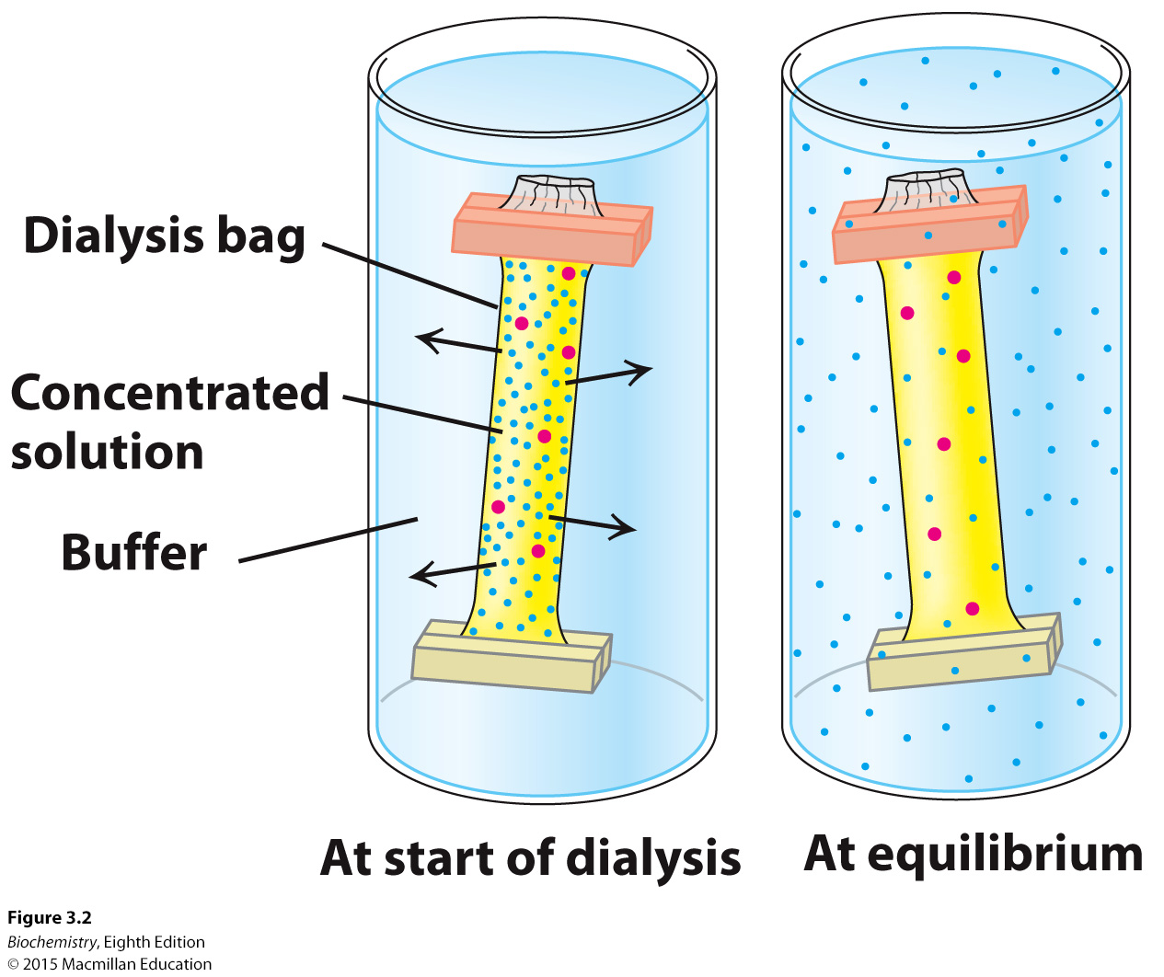
Water moves across a semipermeable membrane when the solute concentrations of the two sides differ
Notes:
FIGURE 3.2 Dialysis. Protein molecules (red) are retained within the dialysis bag, whereas small molecules (blue) diffuse down their concentration gradient into the surrounding medium.

Slide 3
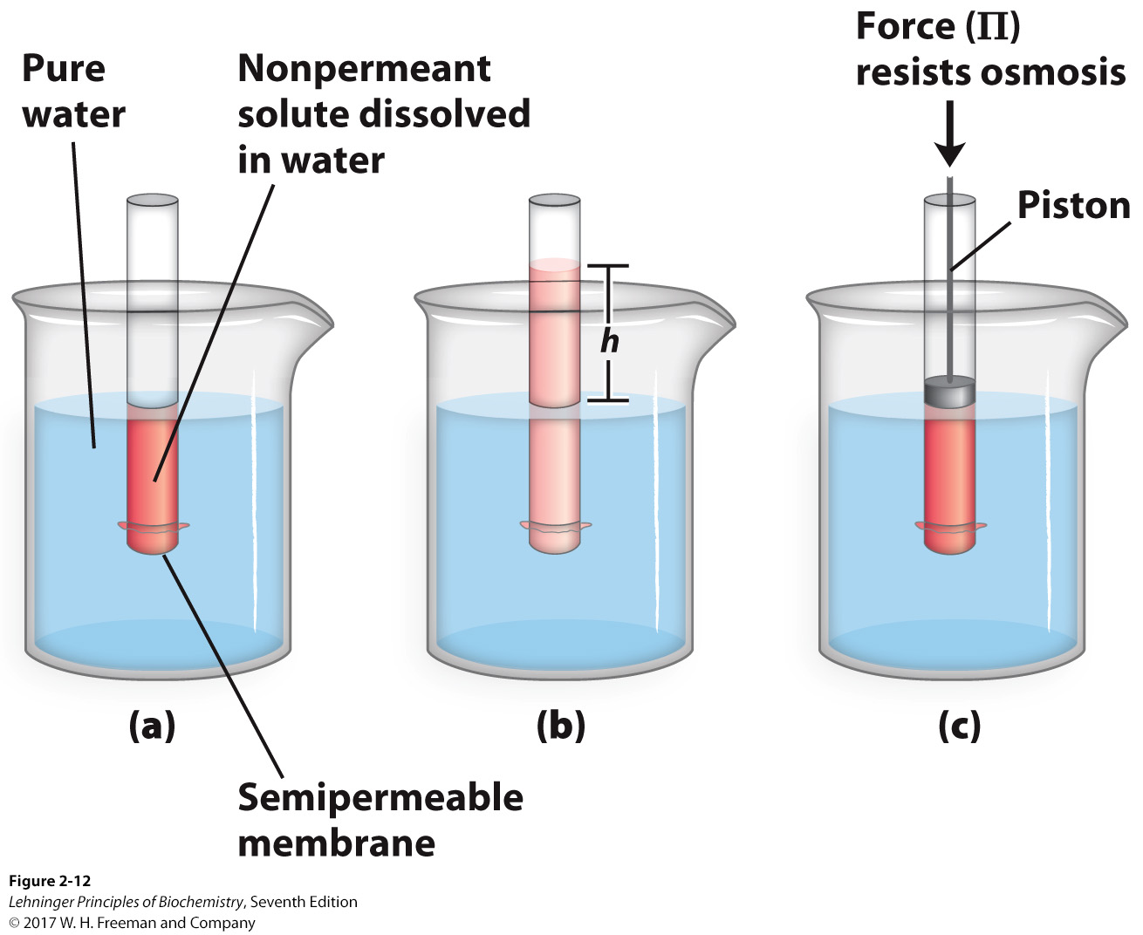
Osmotic concentration & Osmotic pressure
Water moves from areas of high water concentration (low solute concentration) to areas of low water concentration (high solute concentration).
Osmotic concentration, formerly known as osmolarity, is the measure of solute concentration, defined as the number of osmoles (Osm) of soluteper litre (L) of solution.
Osmotic pressure (π) is the force necessary to resist the movement.
Notes:
FIGURE 2-12 Osmosis and the measurement of osmotic pressure. (a) The initial state. The tube contains an aqueous solution, the beaker contains pure water, and the semipermeable membrane allows the passage of water but not solute. Water flows from the beaker into the tube to equalize its concentration across the membrane. (b) The final state. Water has moved into the solution of the nonpermeant compound, diluting it and raising the column of water within the tube. At equilibrium, the force of gravity operating on the solution in the tube exactly balances the tendency of water to move into the tube, where its concentration is lower. (c) Osmotic pressure (Π) is measured as the force that must be applied to return the solution in the tube to the level of that in the beaker. This force is proportional to the height, h, of the column in (b).

Slide 4
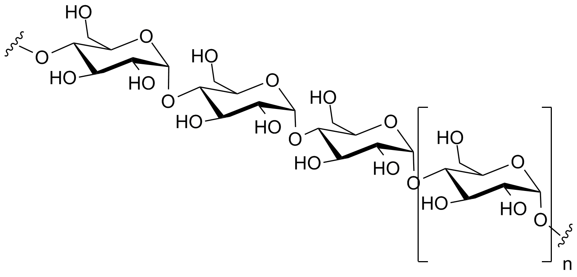
Osmolarity is a colligative property
Depending on the number of solute particles, not its chemical property or mass!
Osmotic pressure is influenced by the concentration of each solute in solution.
Dissociated components of a solute individually influence the osmotic pressure.
A gram of polysaccharide composed of 1000 glucose units has the same effect on osmolarity as a milligram of glucose.

Slide 5
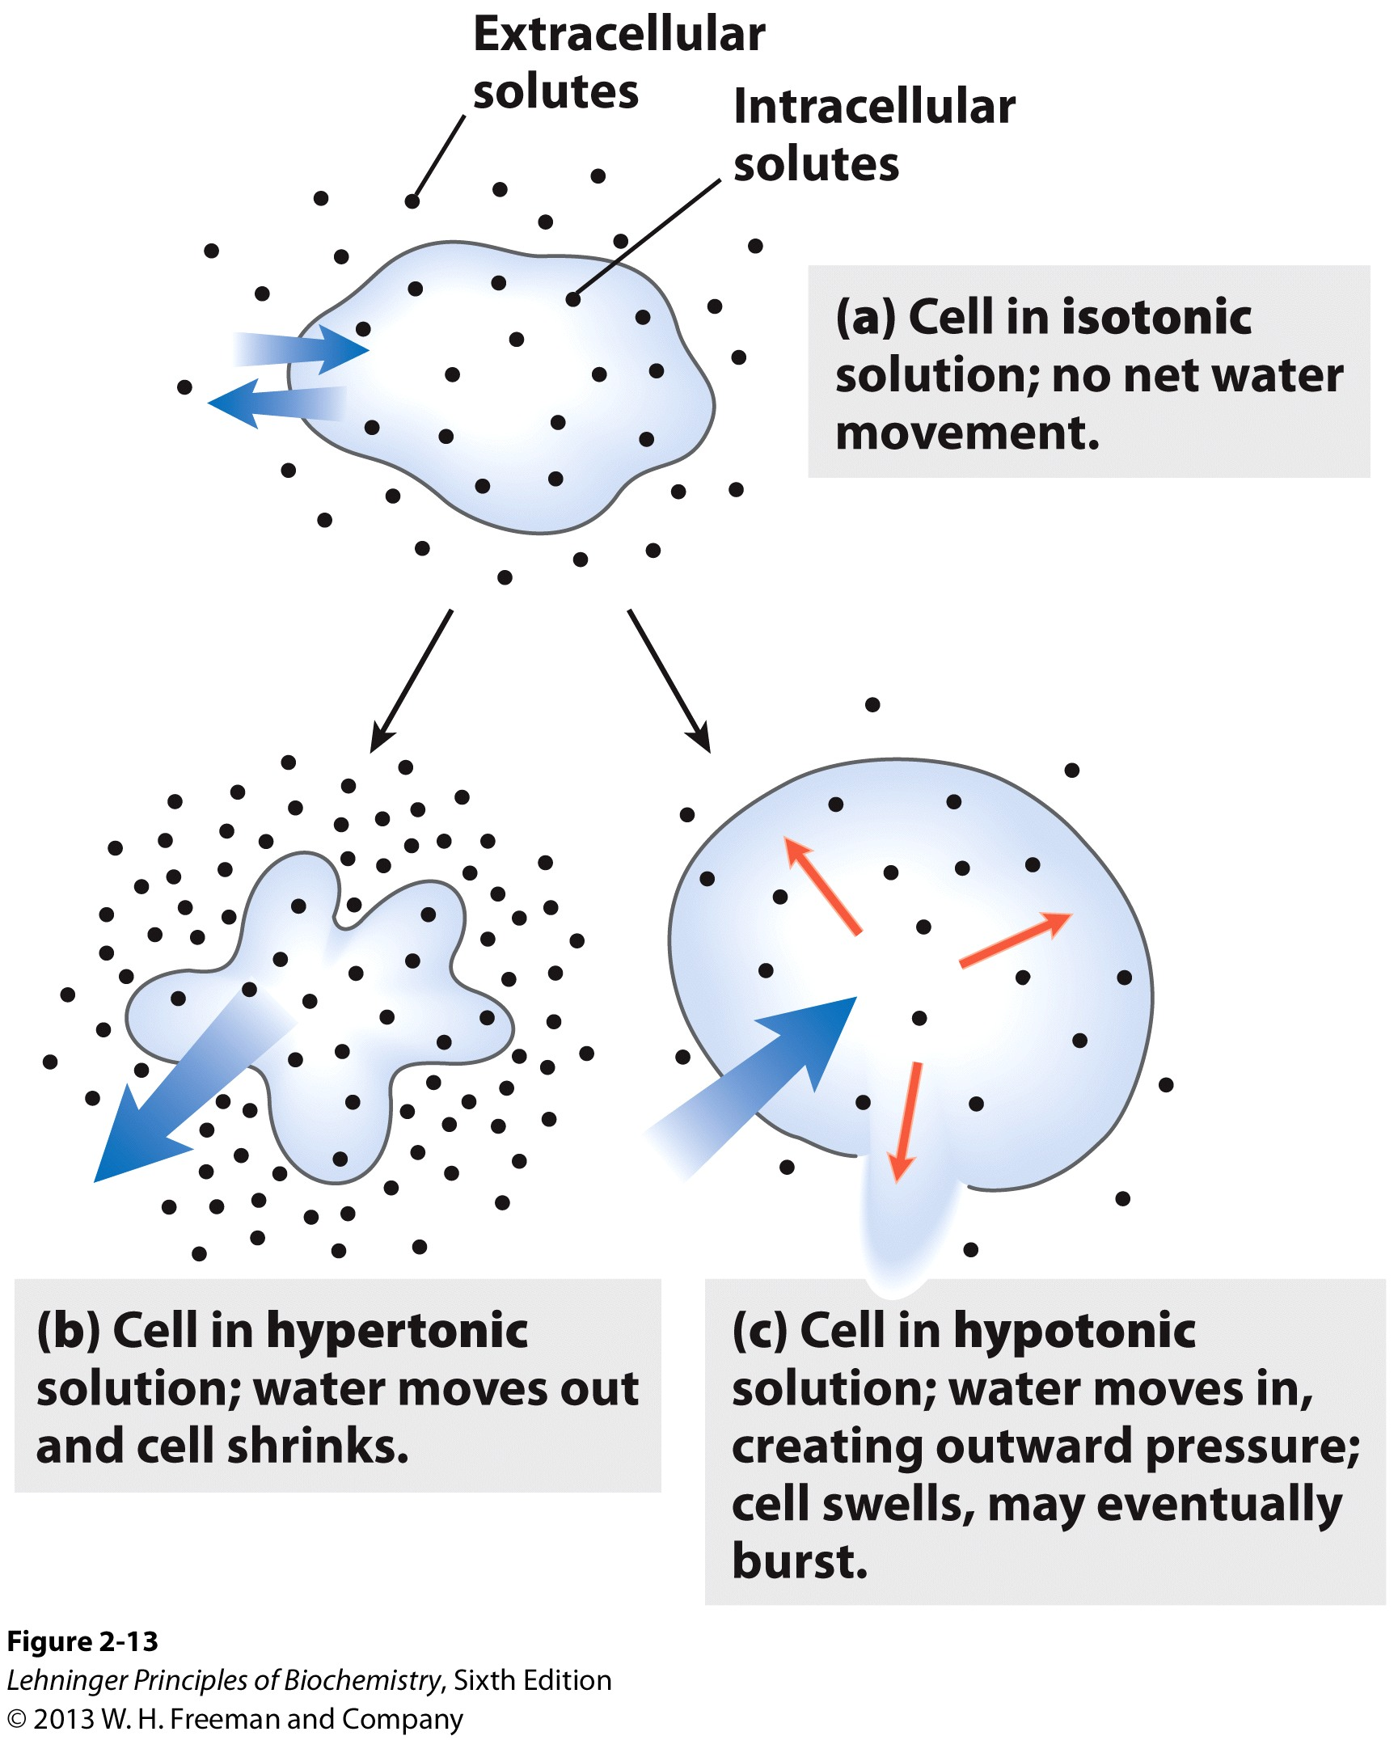
The plasma membrane is a semipermeable membrane
Blood plasma and the extracellular fluid of tissues are maintained at an osmolarity close to that of the cytosol
Plant cells use osmotic pressure to achieve mechanical rigidity
Isotonic solutions need to be used to isolate cells or organelles
Notes:
FIGURE 2-13 Effect of extracellular osmolarity on water movement across a plasma membrane. When a cell in osmotic balance with its surrounding medium—that is, a cell in (a) an isotonic medium—is transferred into (b) a hypertonic solution or (c) a hypotonic solution, water moves across the plasma membrane in the direction that tends to equalize osmolarity outside and inside the cell.

Slide 6
Work example 2-1
Suppose the major solutes in intact lysosomes are KCl (~ 0.1 M) and NaCl (~0.03 M). When isolating lysosomes, what concentration of sucrose is required in the extracting solution to prevent swelling and lysis?

Slide 7
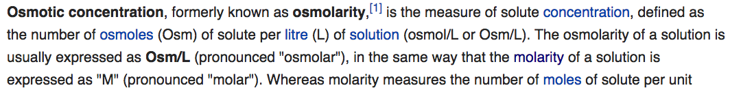
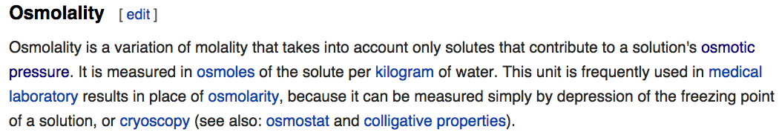

Slide 8
Pure water is slightly ionized
→
H₂O H⁺ + OH⎼
←
Produce a proton (H⁺) and a hydroxide ion (OH–).
Most water molecules remain un-ionized, thus pure water has very low electrical conductivity (resistance: 18 MΩ•cm).
Protons do not exist free in solution. They are immediately hydrated to form hydronium ions (H₃O⁺).
The covalent and hydrogen bonds are interchangeable. This allows for an extremely fast mobility of protons in water via “proton hopping.”

Slide 9
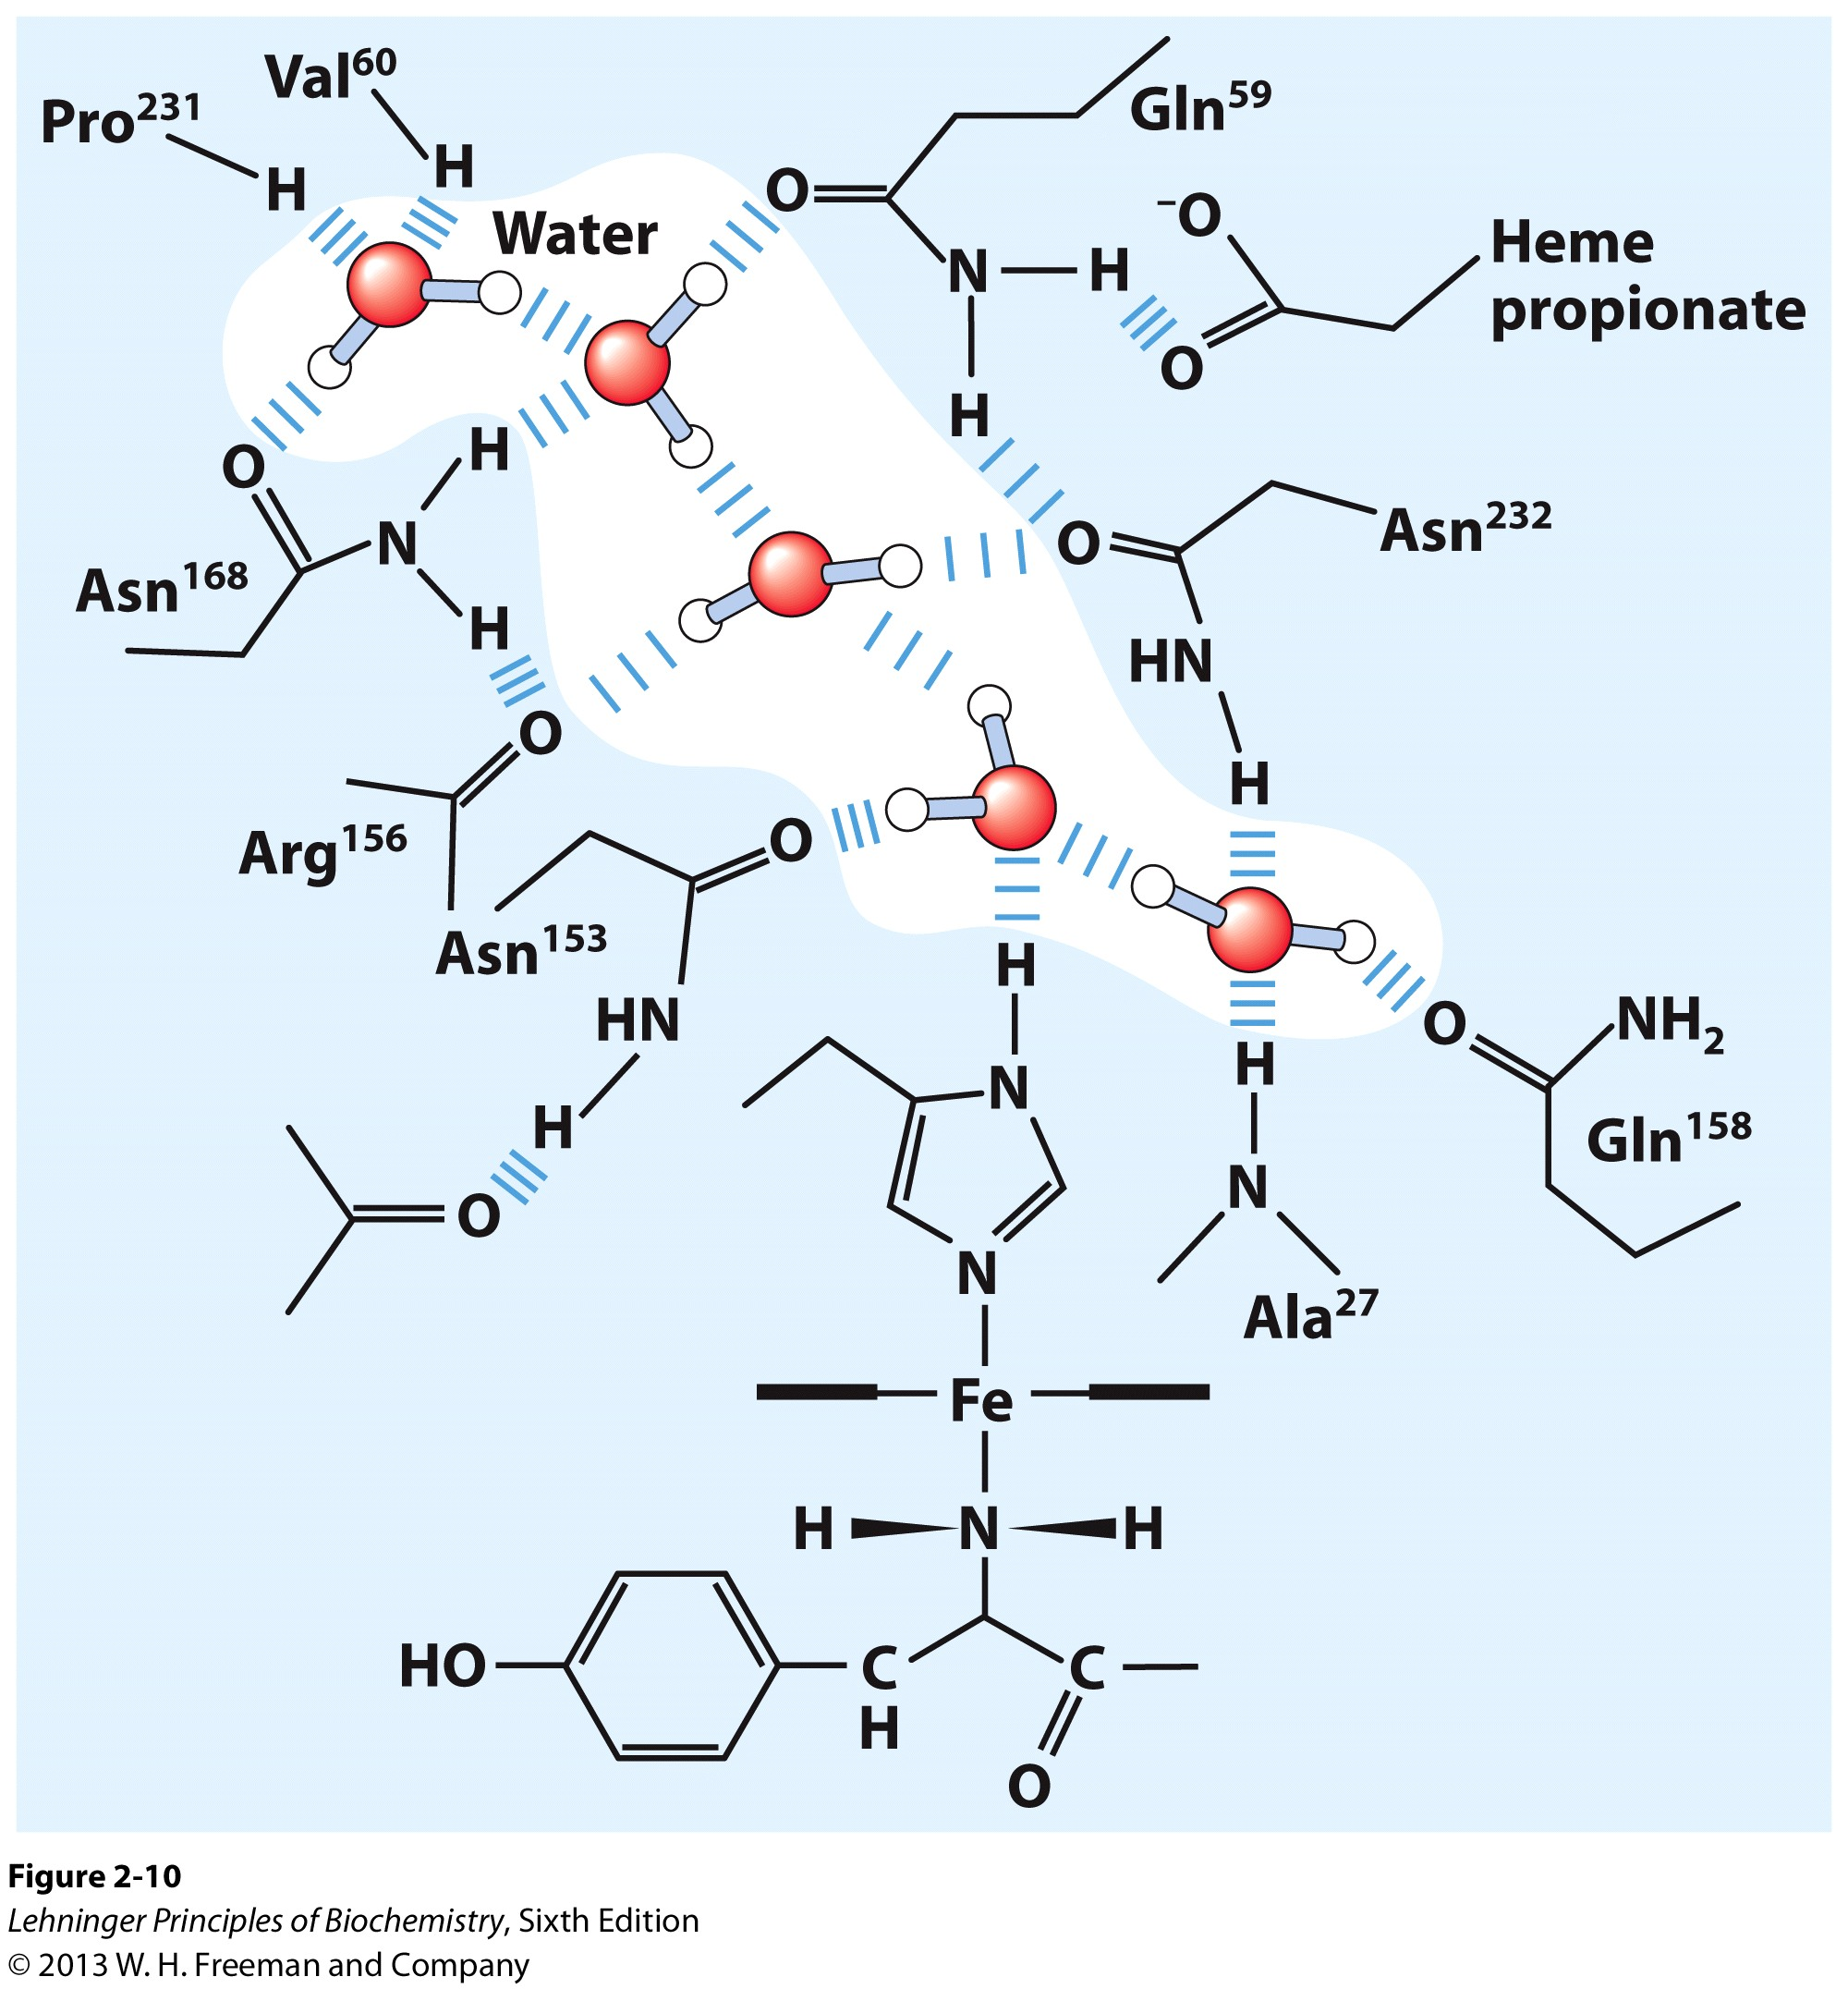
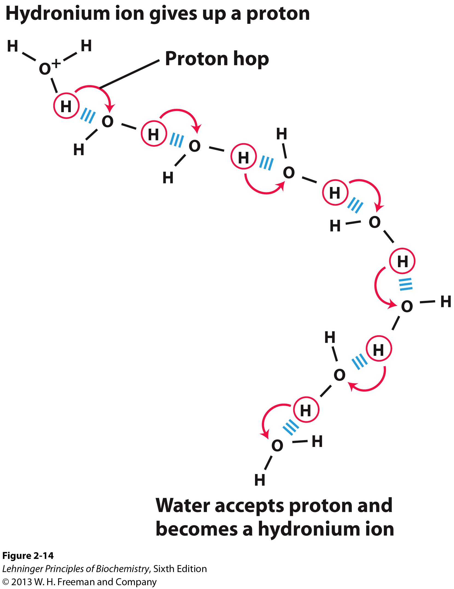
Proton hopping
Cytochrome f
(a chain of water molecules Likely function in “proton Hopping” across the cell membrane)
Notes:
FIGURE 2-14 Proton hopping. Short “hops” of protons between a series of hydrogen-bonded water molecules result in an extremely rapid net movement of a proton over a long distance. As a hydronium ion (upper left) gives up a proton, a water molecule some distance away (lower right) acquires one, becoming a hydronium ion. Proton hopping is much faster than true diffusion and explains the remarkably high ionic mobility of H⁺ ions compared with other monovalent cations such as Na⁺ and K⁺.
FIGURE 2–10 Water chain in cytochrome f. Water is bound in a proton channel of the membrane protein cytochrome f, which is part of the energy-trapping machinery of photosynthesis in chloroplasts (see Fig. 19–61). Five water molecules are hydrogen-bonded to each other and to functional groups of the protein: the peptide backbone atoms of valine, proline, arginine, and alanine residues, and the side chains of three asparagine and two glutamine residues. The protein has a bound heme (see Fig. 5–1), its iron ion facilitating electron flow during photosynthesis. Electron flow is coupled to the movement of protons across the membrane, which probably involves “proton hopping” (see Fig. 2–14) through this chain of bound water molecules.

Slide 10
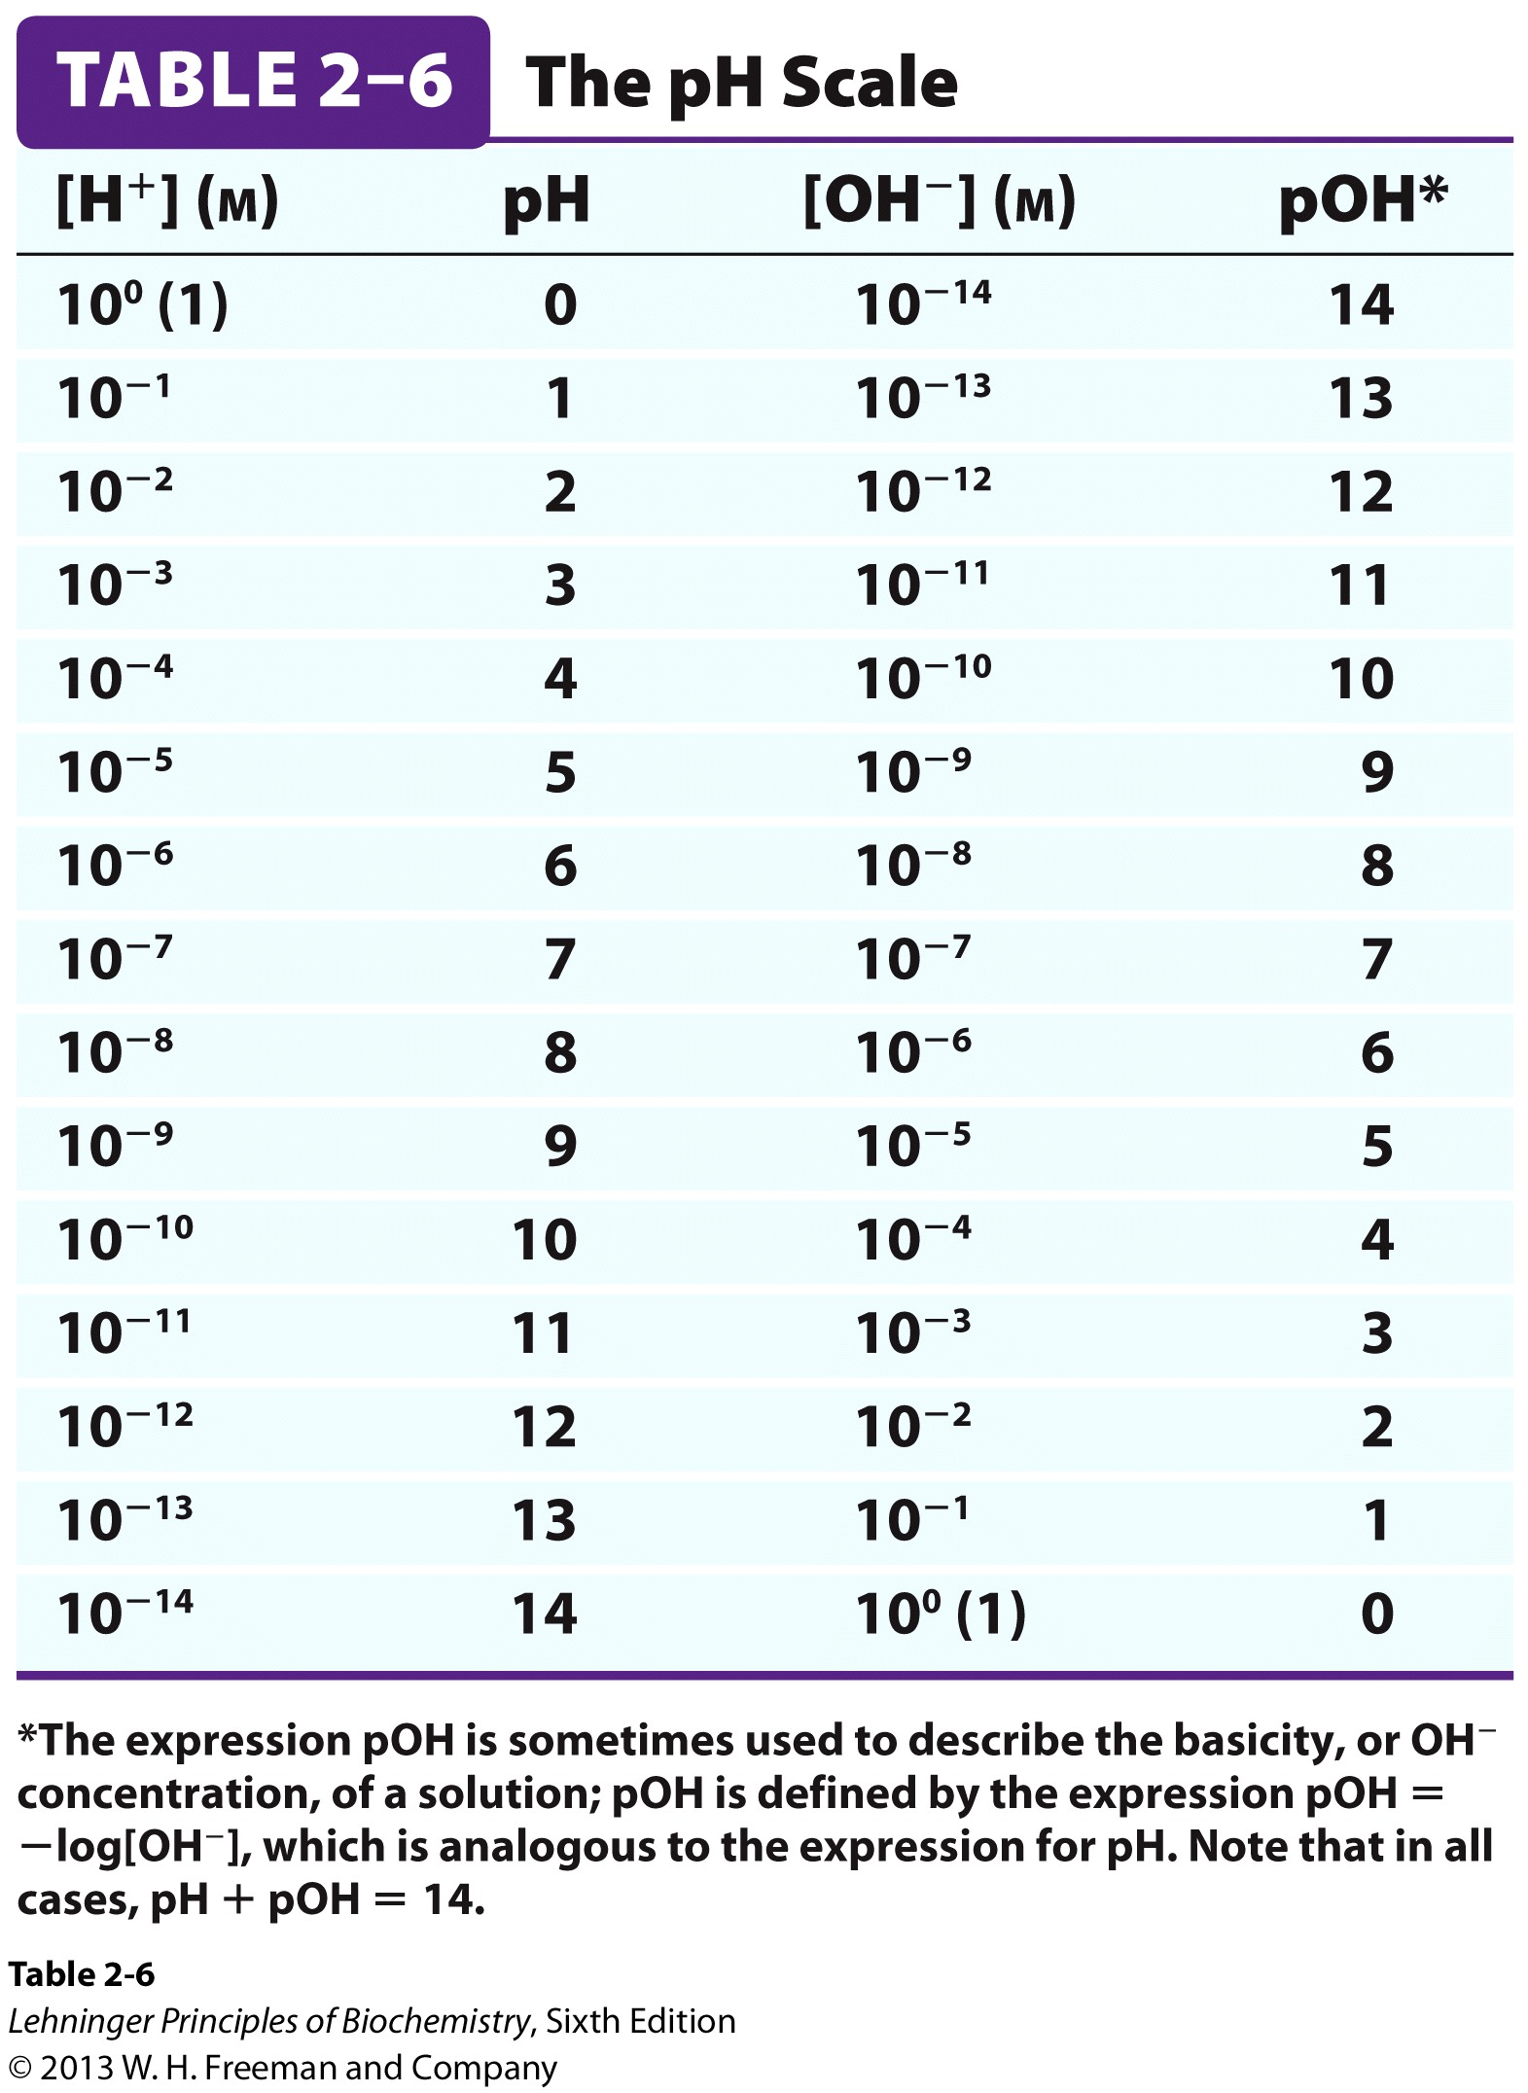
The concentration of H⁺ in an aqueous solution is designated by its pH value
pH = −log[H⁺]
p denotes “negative logarithm of”
At neutral condition, [H⁺] = [OH⁻] = 10 ⁻⁷ M, thus pH = 7
pH Scale Is Logarithmic: 1 unit = 10-fold
The pH and pOH always add up to 14.
pH can be negative, for example, when [H⁺] = 6 M.

Slide 11
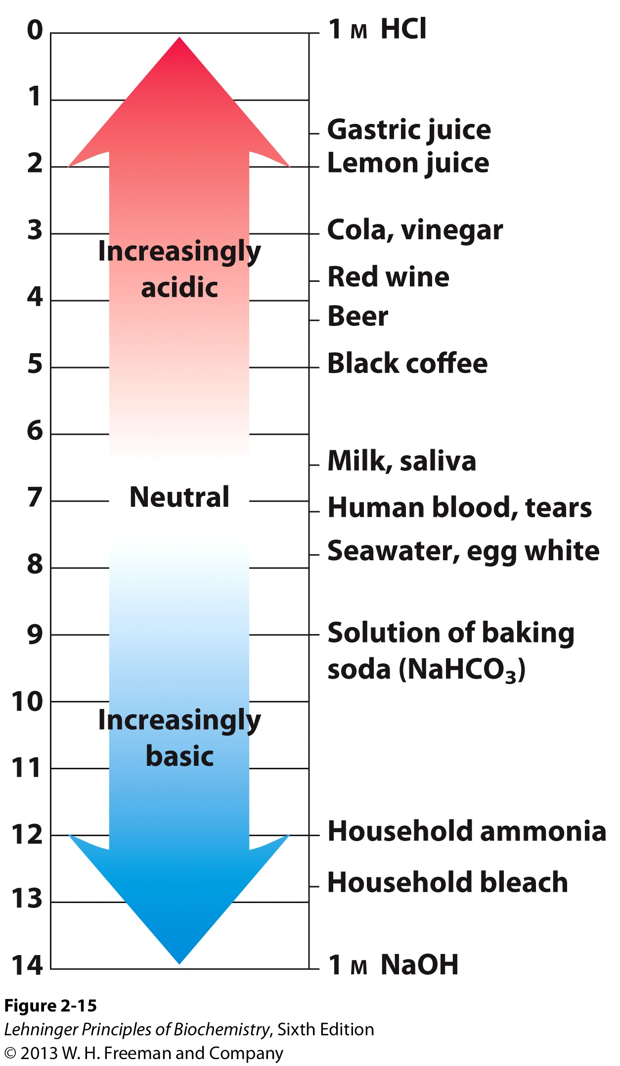
pH of some common liquids

Slide 12
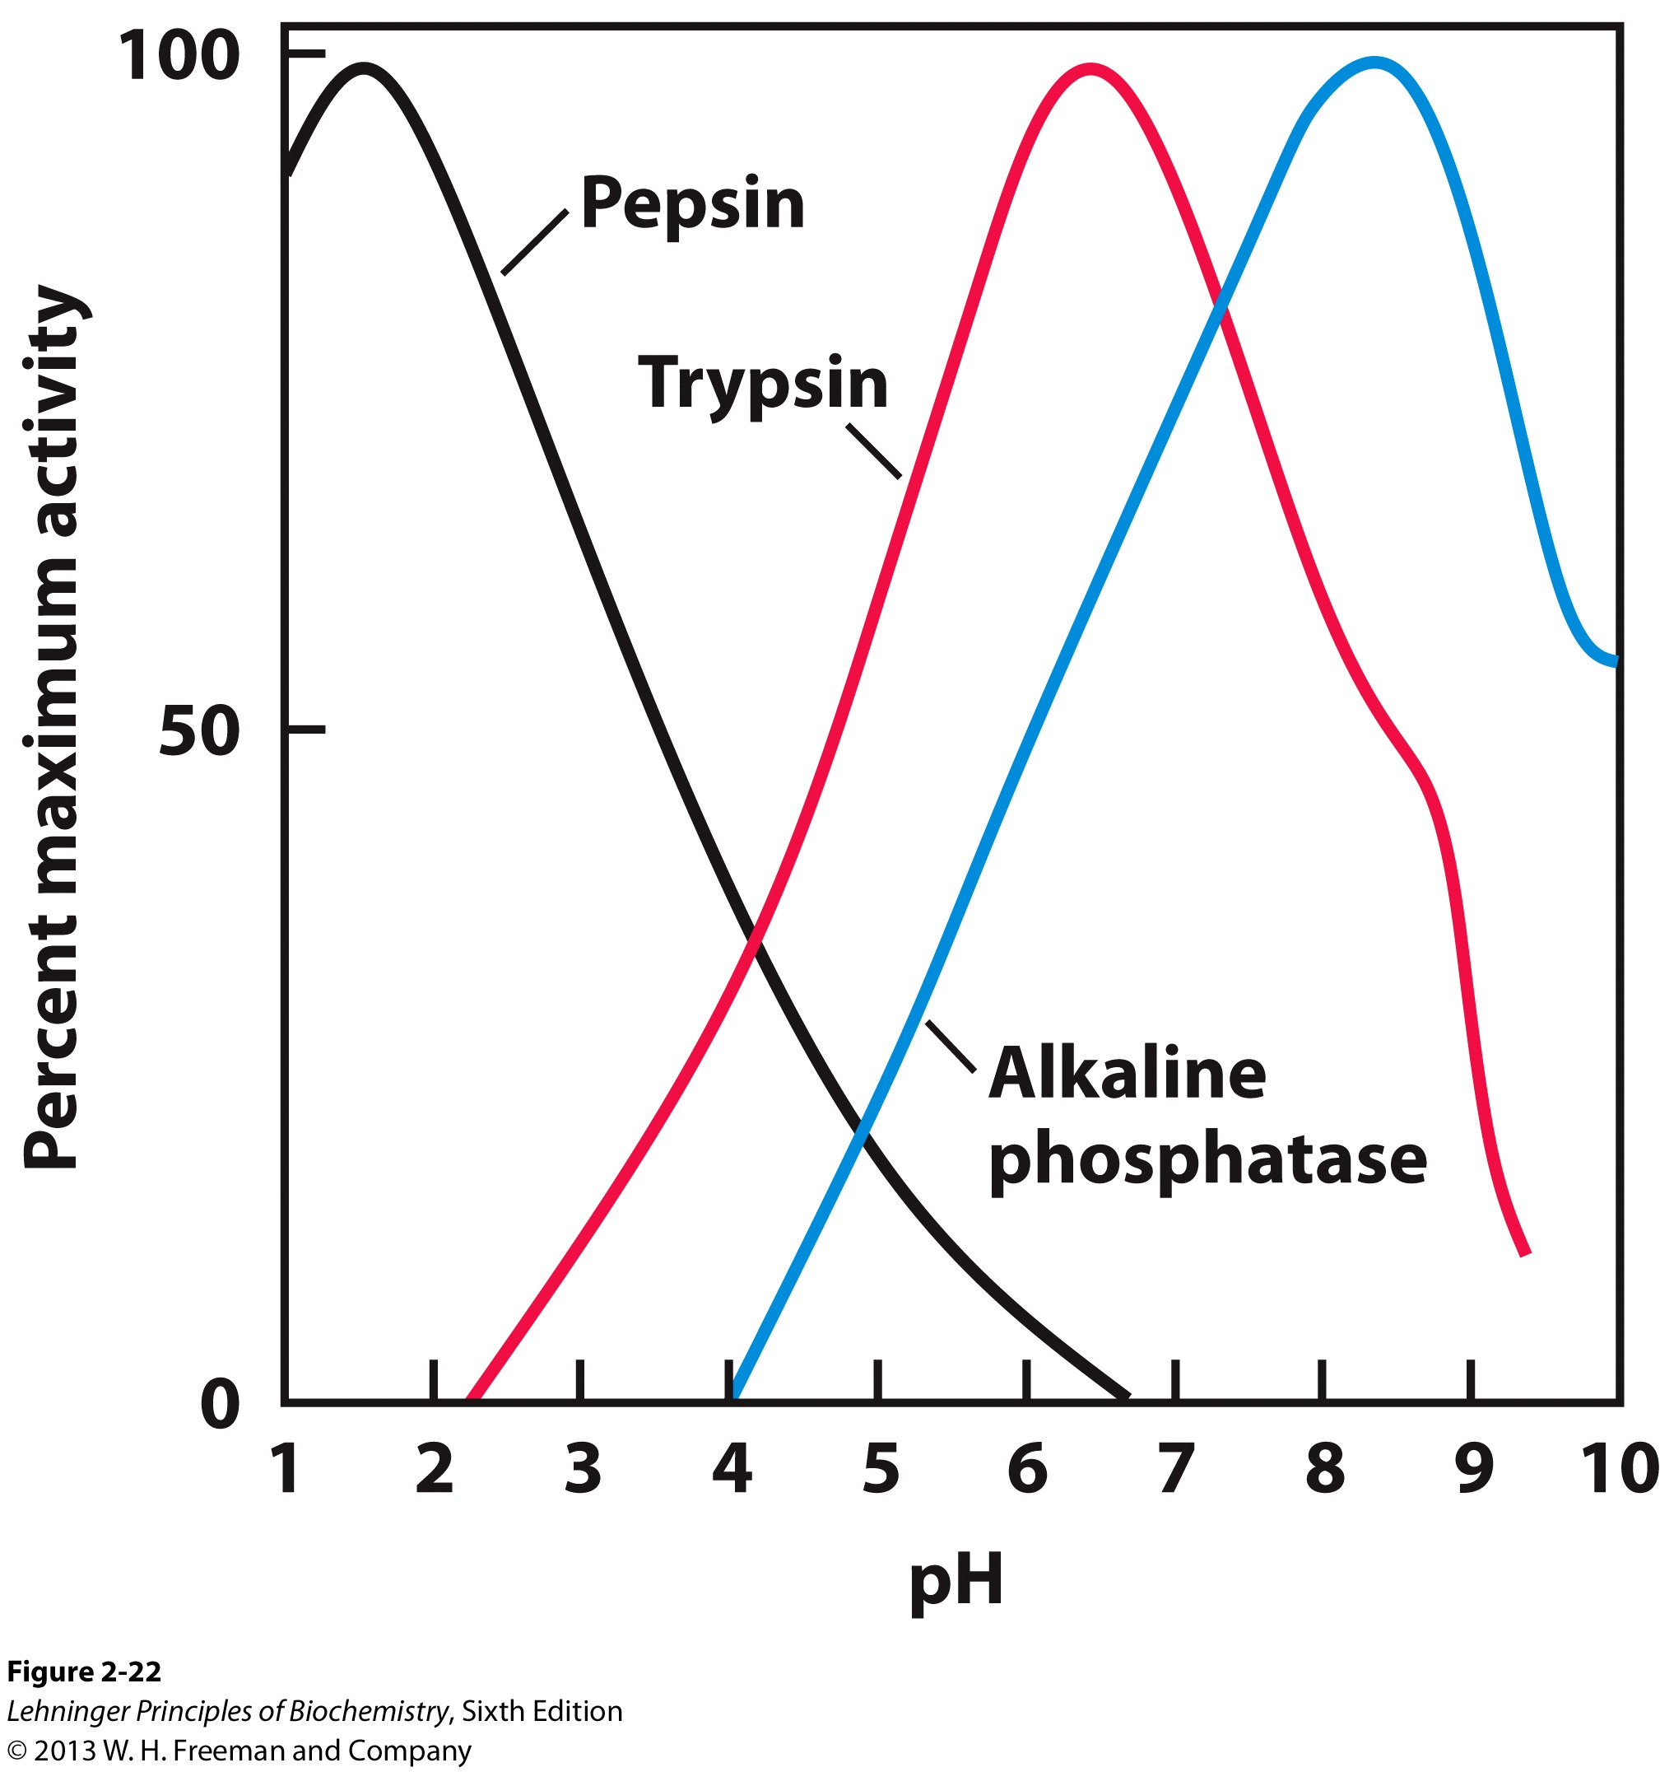
Each biological system needs to maintain a constant pH for normal function
Almost every biological process is pH-dependent: most biomolecules (e.g., enzymes) function at an optimal pH.
The human blood plasma normally has a pH between 7.35-7.45.
It is life-threatening when blood pH is lower than 7 (e.g., in severe diabetic patients)

Slide 13
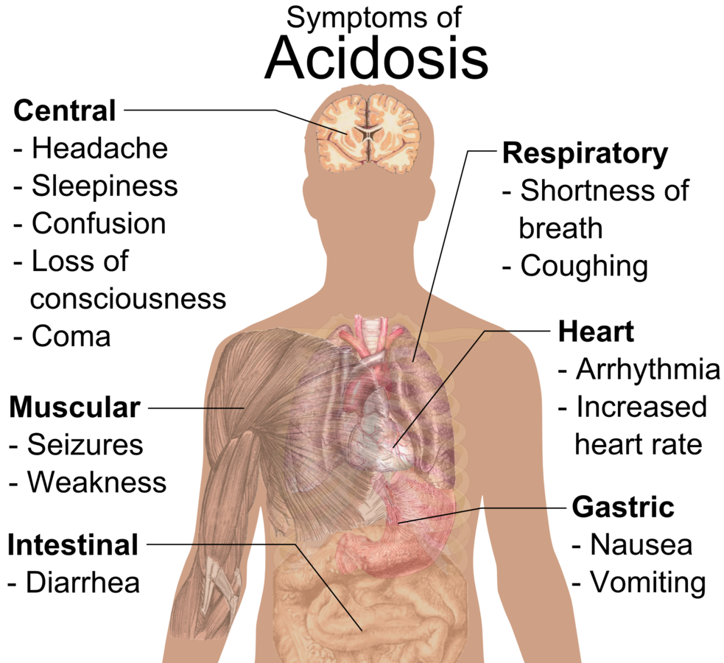
Increased acidity in the blood and other tissue leads to Acidosis (酸中毒)

Slide 14
Strong acids and weak acids
HCl → H⁺ + Cl⁻
CH₃COOH ⇌ H⁺ + CH₃COO⁻

Slide 15
Henderson–Hasselbalch Equation
←
HA H⁺ + A⁻
→
Notes:
Ka: ionization constant, or acid dissociation constant
The pKa of a weak acid is equal to the pH of the solution in which [A⁻] = [HA]
The pH of a solution of a weak acid and its salt (base) can be deduced if the pKa is known.

Slide 16
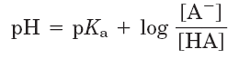
Work example 2-2
H₂PO₄⁻ ⇌ H⁺ + HPO₄²⁻, pKa = 6.86
What is the pH of a mixture of 0.01 M NaH₂PO₄ and 0.1 M Na₂HPO₄?

Slide 17
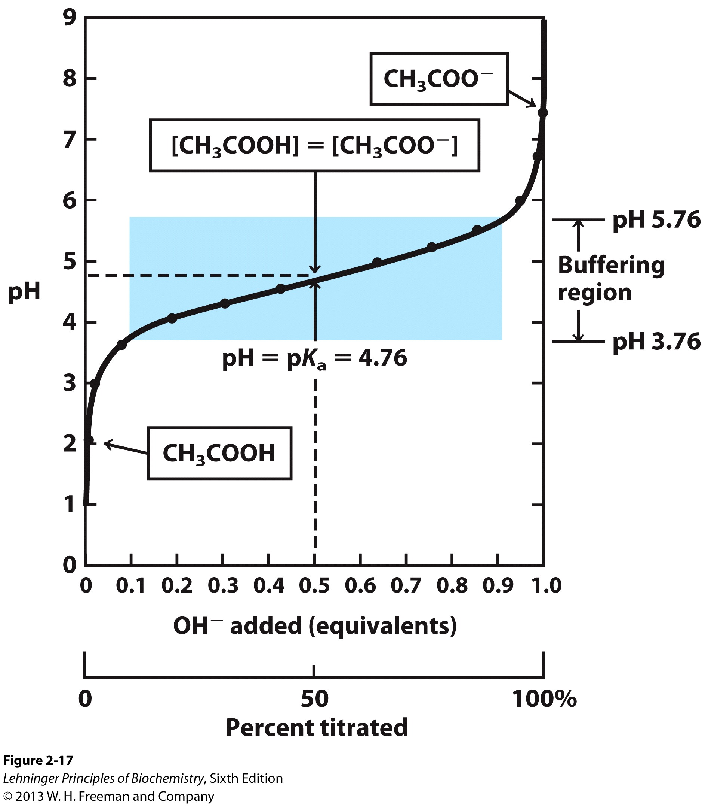
Titration curves of weak acids
A weak acid and its conjugate base make up a buffer system.
Buffering capacity of acid/anion system is greatest at pH = pK_{a.}
Buffering capacity is lost when the pH differs from pK_{a} by more than 1 pH unit.
Notes:
FIGURE 2-17 The titration curve of acetic acid. After addition of each increment of NaOH to the acetic acid solution, the pH of the mixture is measured. This value is plotted against the amount of NaOH added, expressed as a fraction of the total NaOH required to convert all the acetic acid (CH₃COOH) to its deprotonated form, acetate (CH₃COO–). The points so obtained yield the titration curve. Shown in the boxes are the predominant ionic forms at the points designated. At the midpoint of the titration, the concentrations of the proton donor and proton acceptor are equal, and the pH is numerically equal to the pK_{a}. The shaded zone is the useful region of buffering power, generally between 10% and 90% titration of the weak acid.

Slide 18
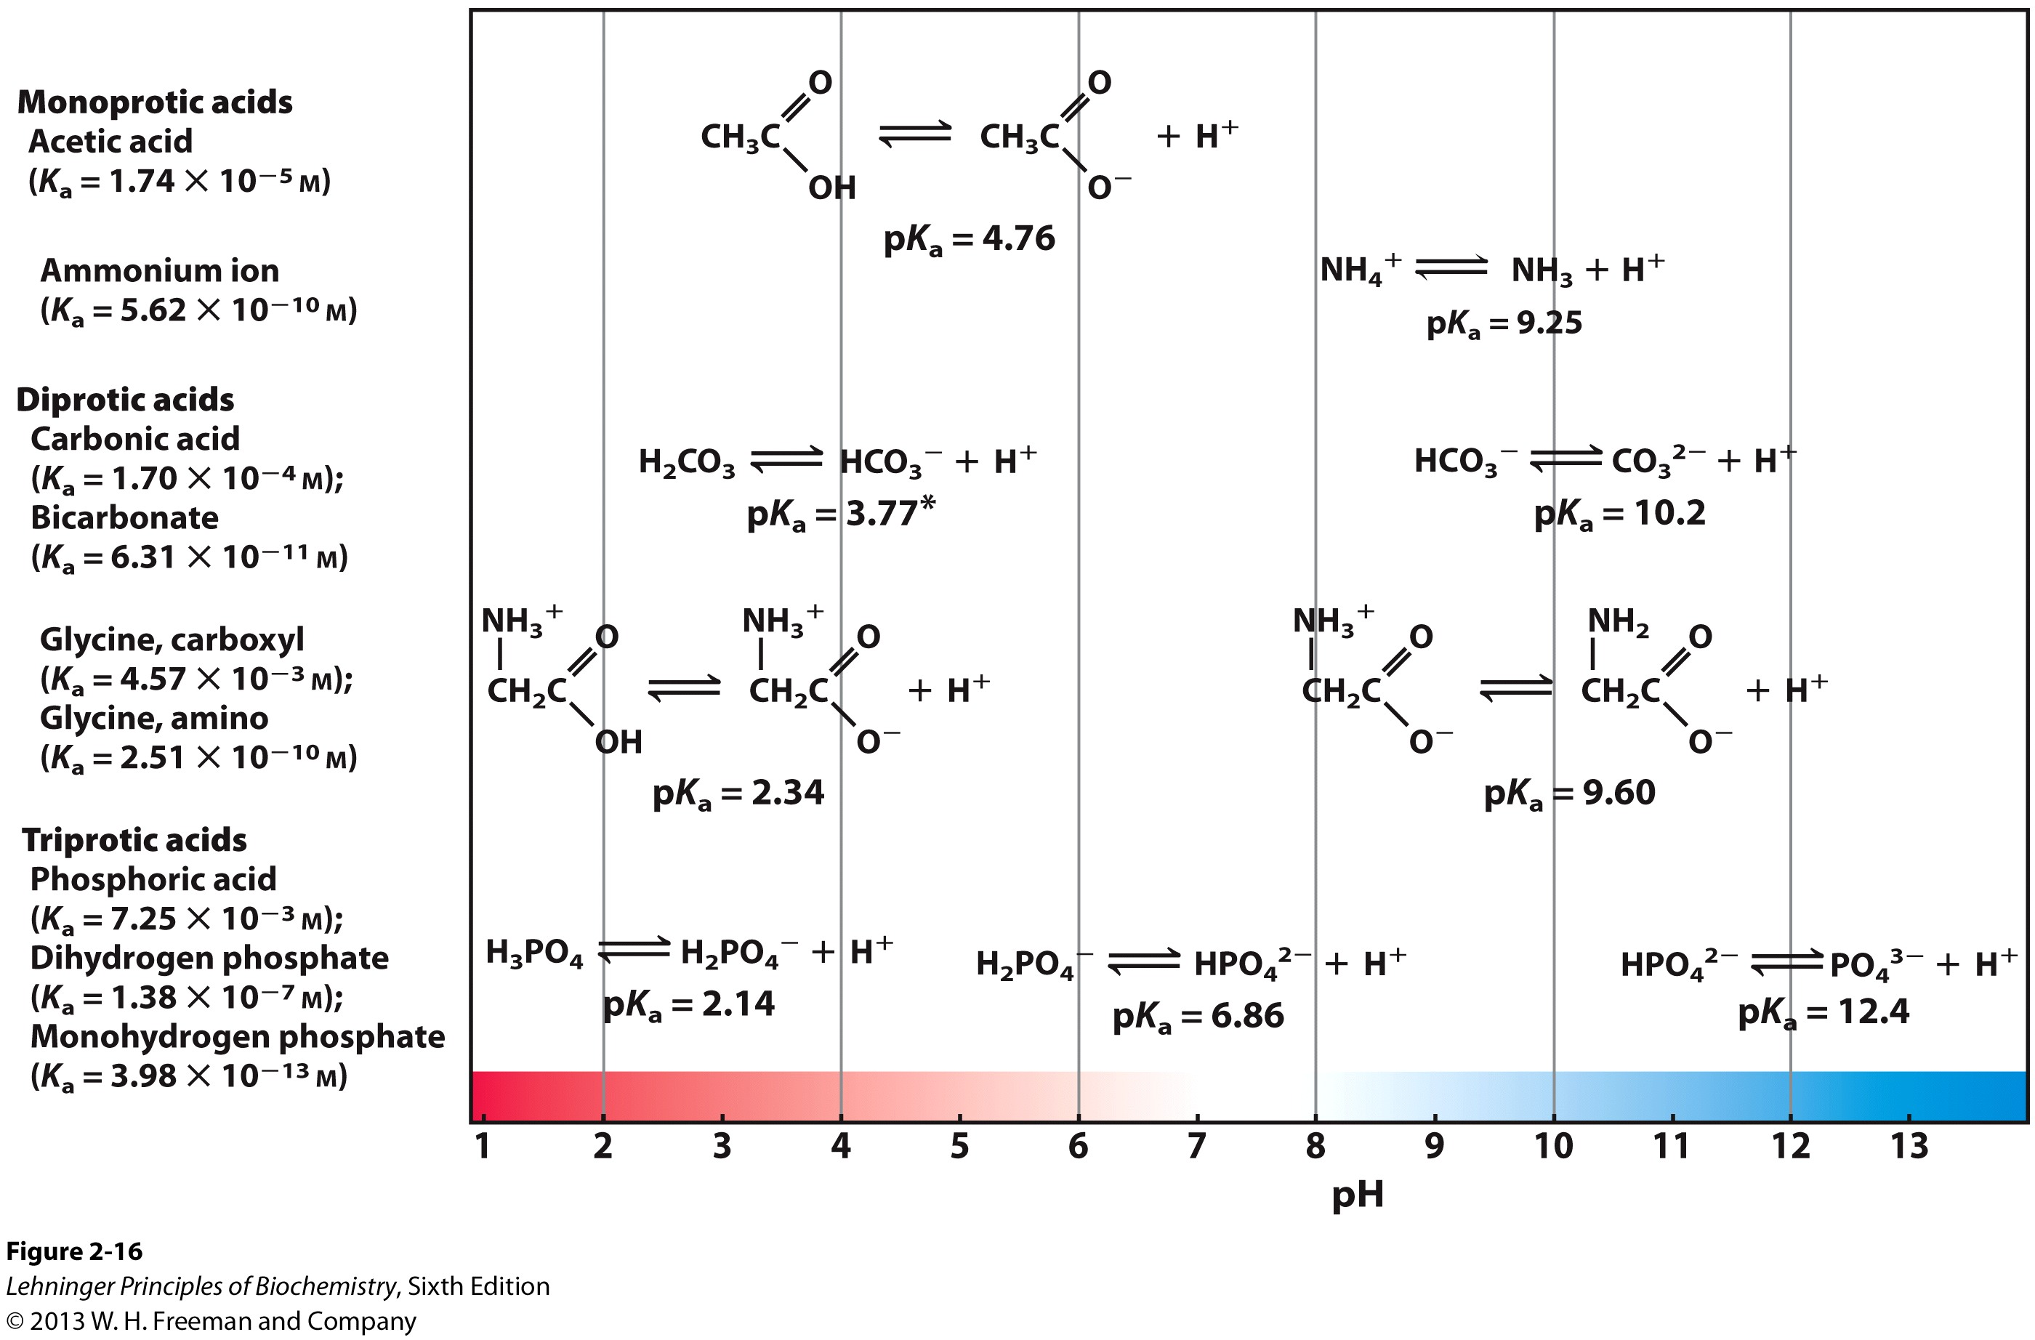
Many biomolecules are weak acids

Slide 19
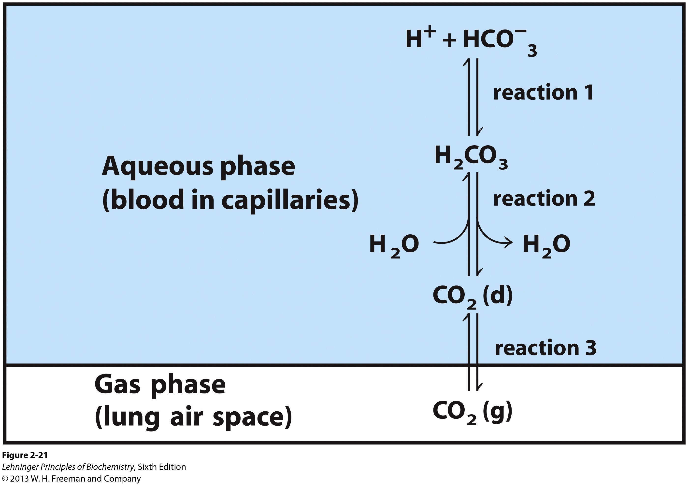
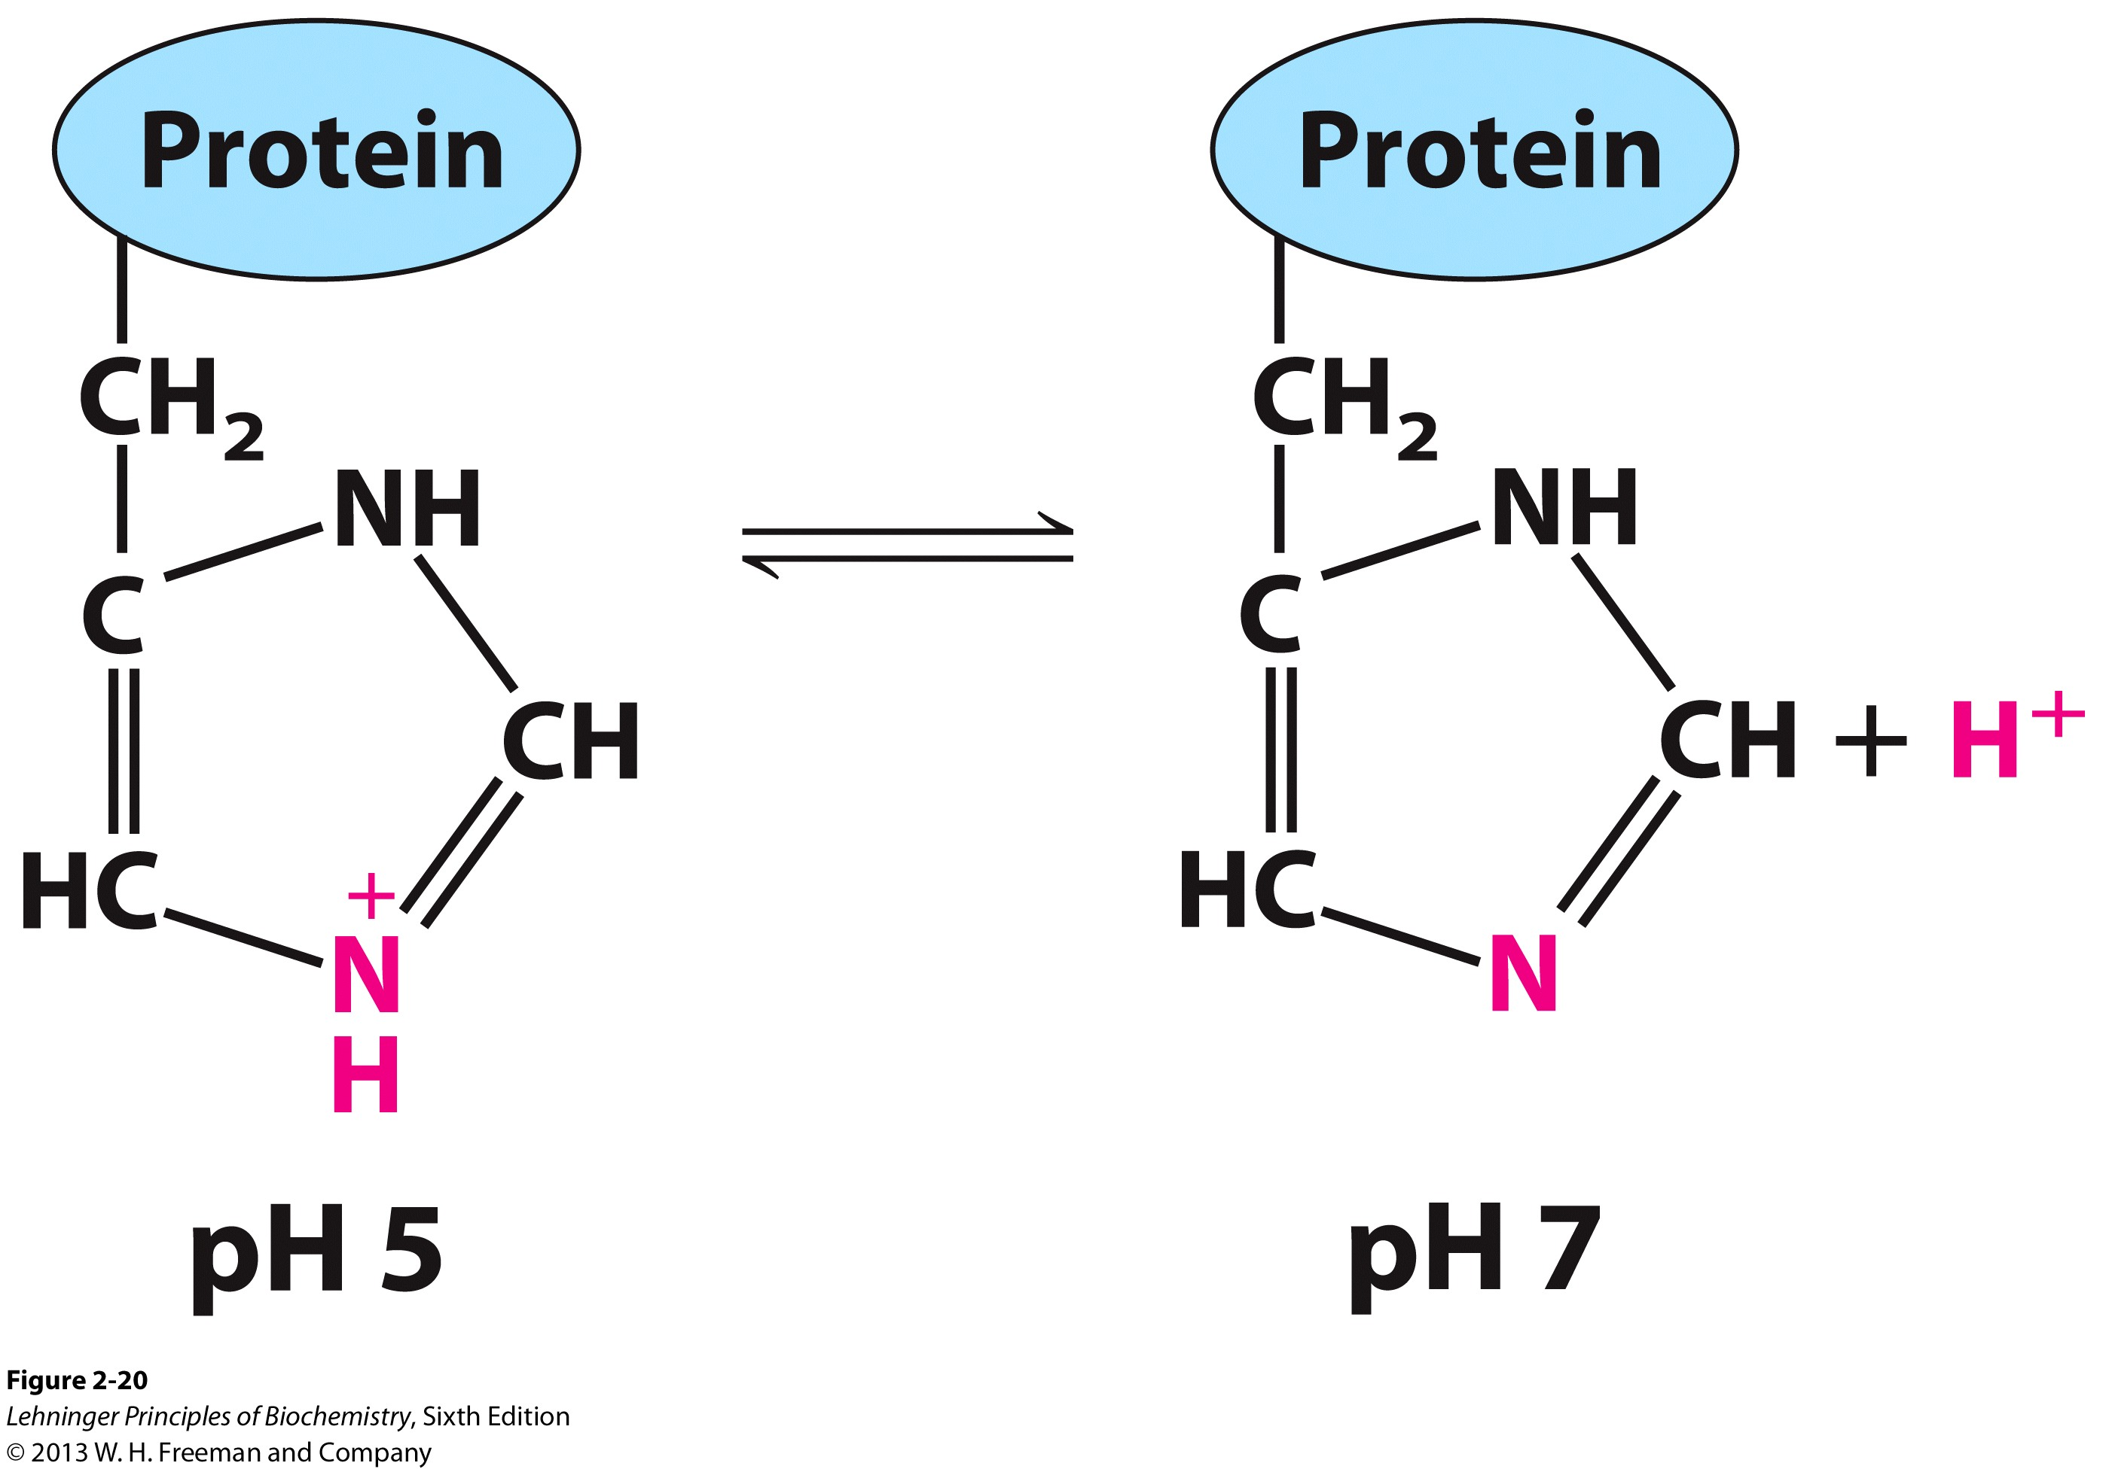
Weak acids in cells and tissues buffer against pH change
pKa = 6.86
pKa = 6.0
pK_{combined} = 6.1

Slide 20
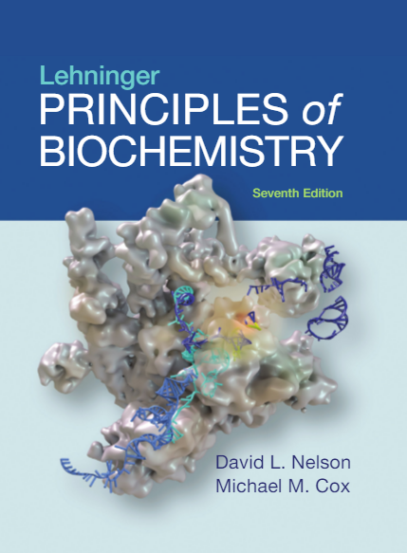
3 | Amino Acids, Peptides, and Proteins
© 2017 W. H. Freeman and Company

Slide 21
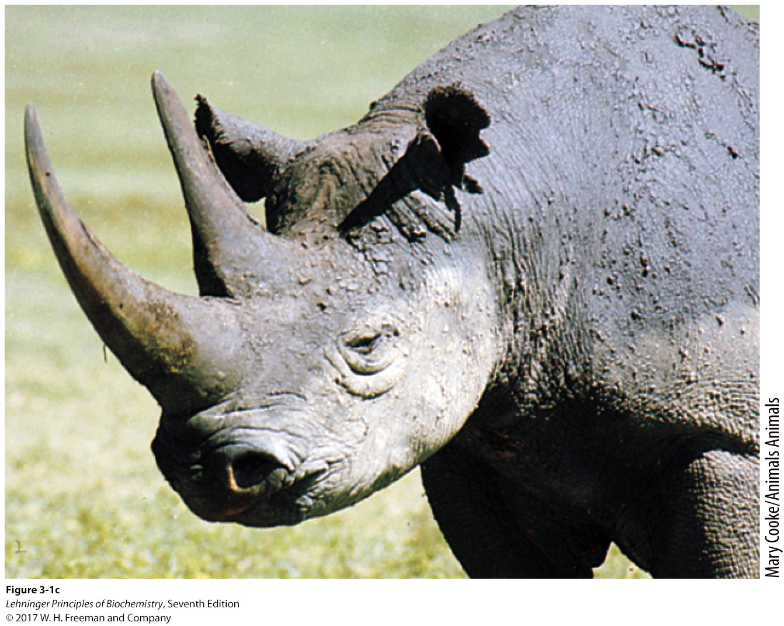
Proteins serve a wide range of biological functions

Slide 22
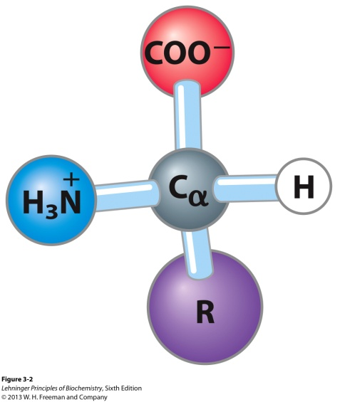
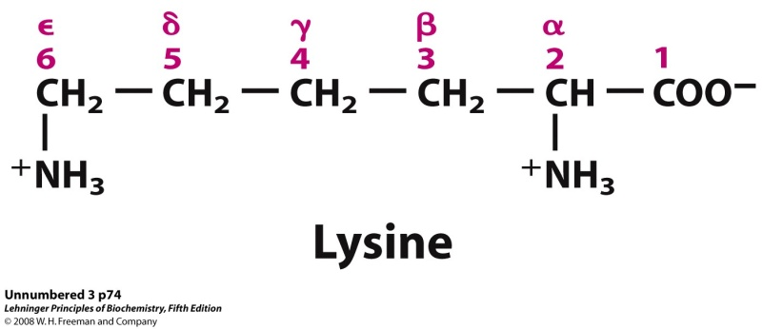
Amino acids: building blocks of protein
Proteins are linear heteropolymers of α-amino acids.
General structure of an amino acid: a primary amino (except Pro) and a carboxyl group, a distinctive side chain (R group), all linked to the α-carbon (thus usually chiral).
The side chains vary in the following: size, shape, polarity, charge, H-bonding capacity, hydrophobicity, chemical reactivity etc.
α
Two ways to designate the carbon atoms

Slide 23
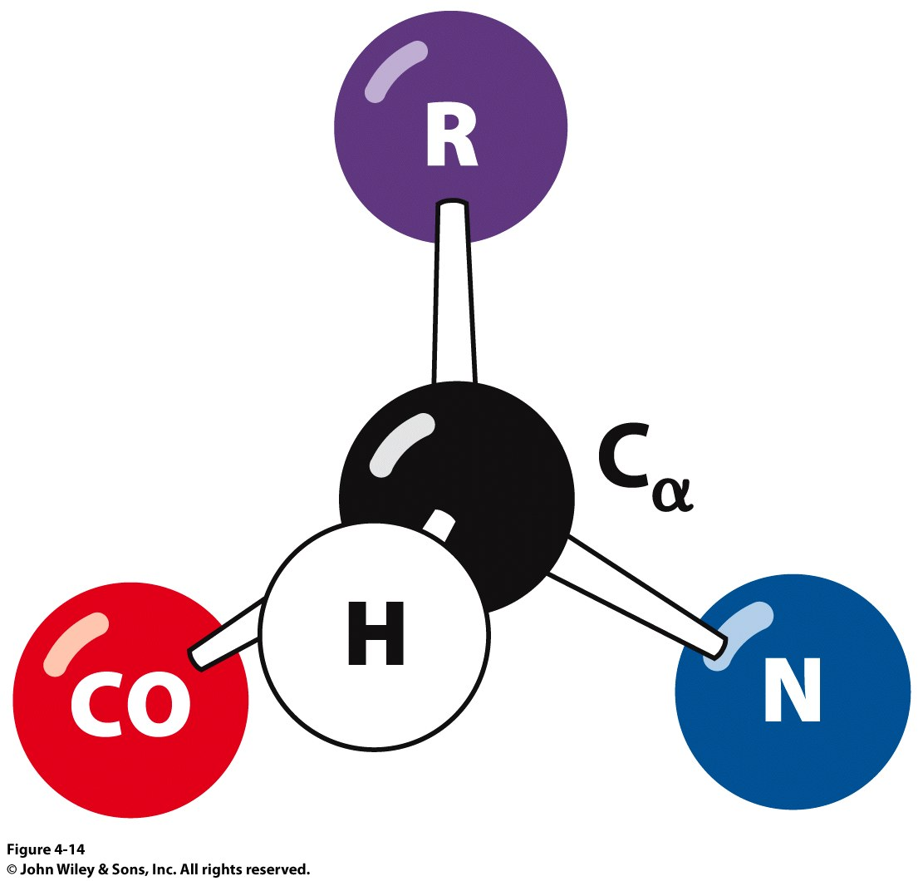
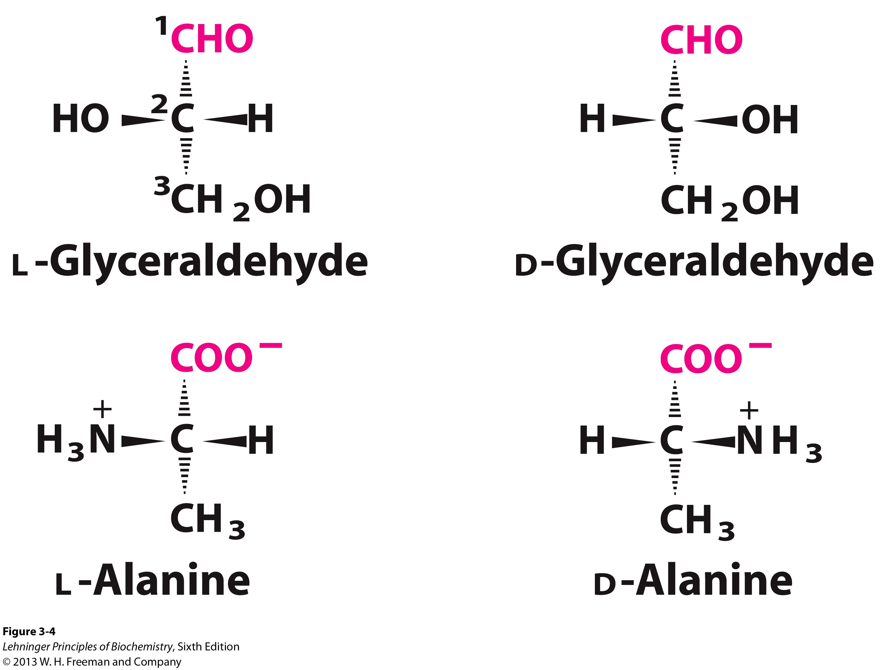
Natural amino acids are L-amino acids
“CoRN”

Slide 24
Amino Acids: Classification
Common amino acids can be placed in five basic groups depending on their R substituents:
nonpolar, aliphatic (7)
aromatic (3)
polar, uncharged (5)
positively charged (3)
negatively charged (2)
You are responsible for knowing the names (full name, three-letter and one-letter abbreviations) of the 20 amino acids and the groups they belong to.

Slide 25
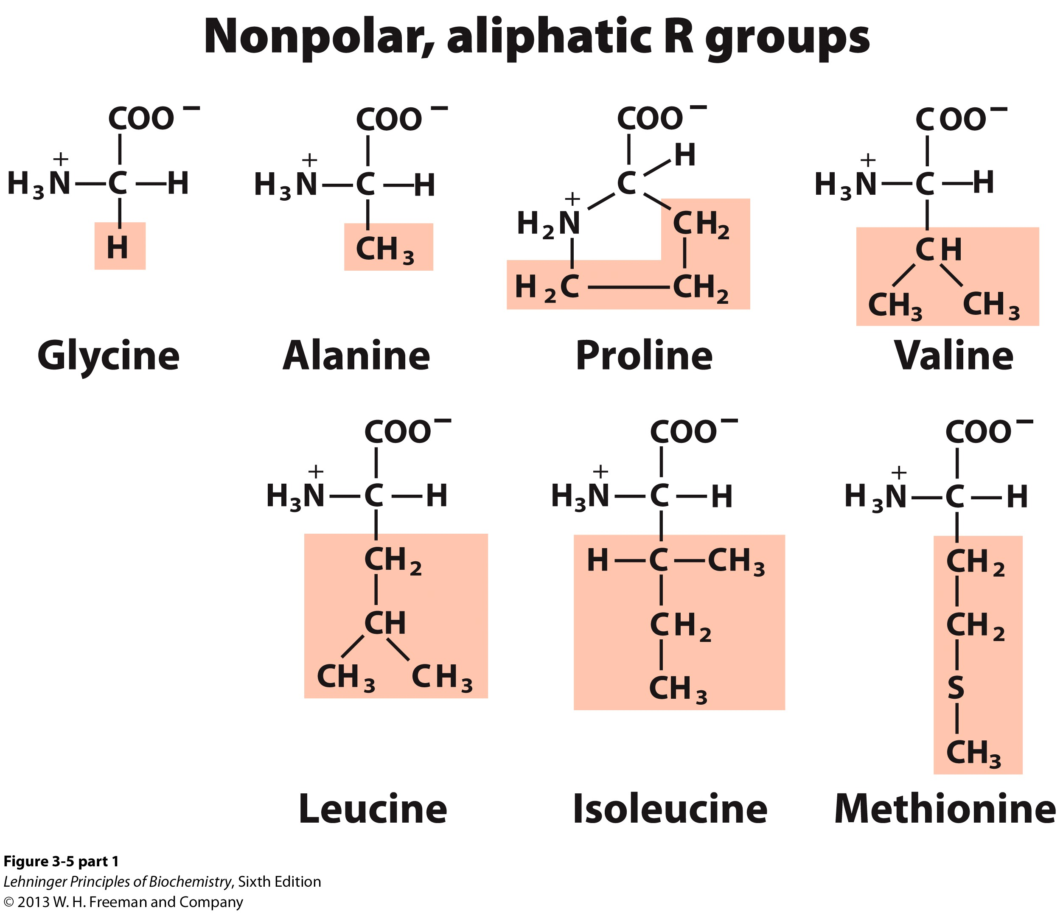

Slide 26
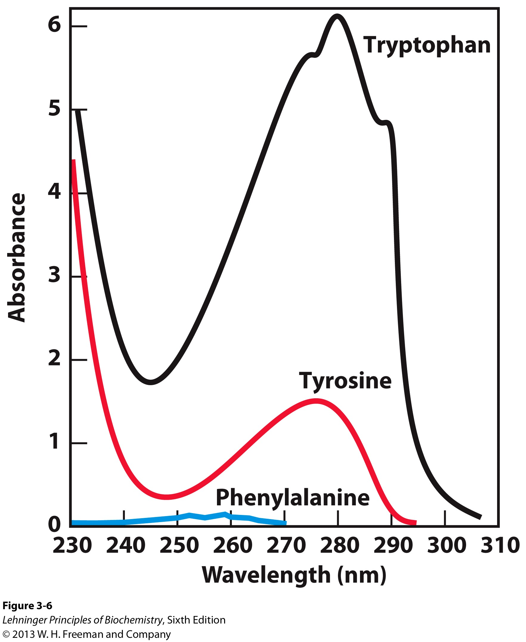
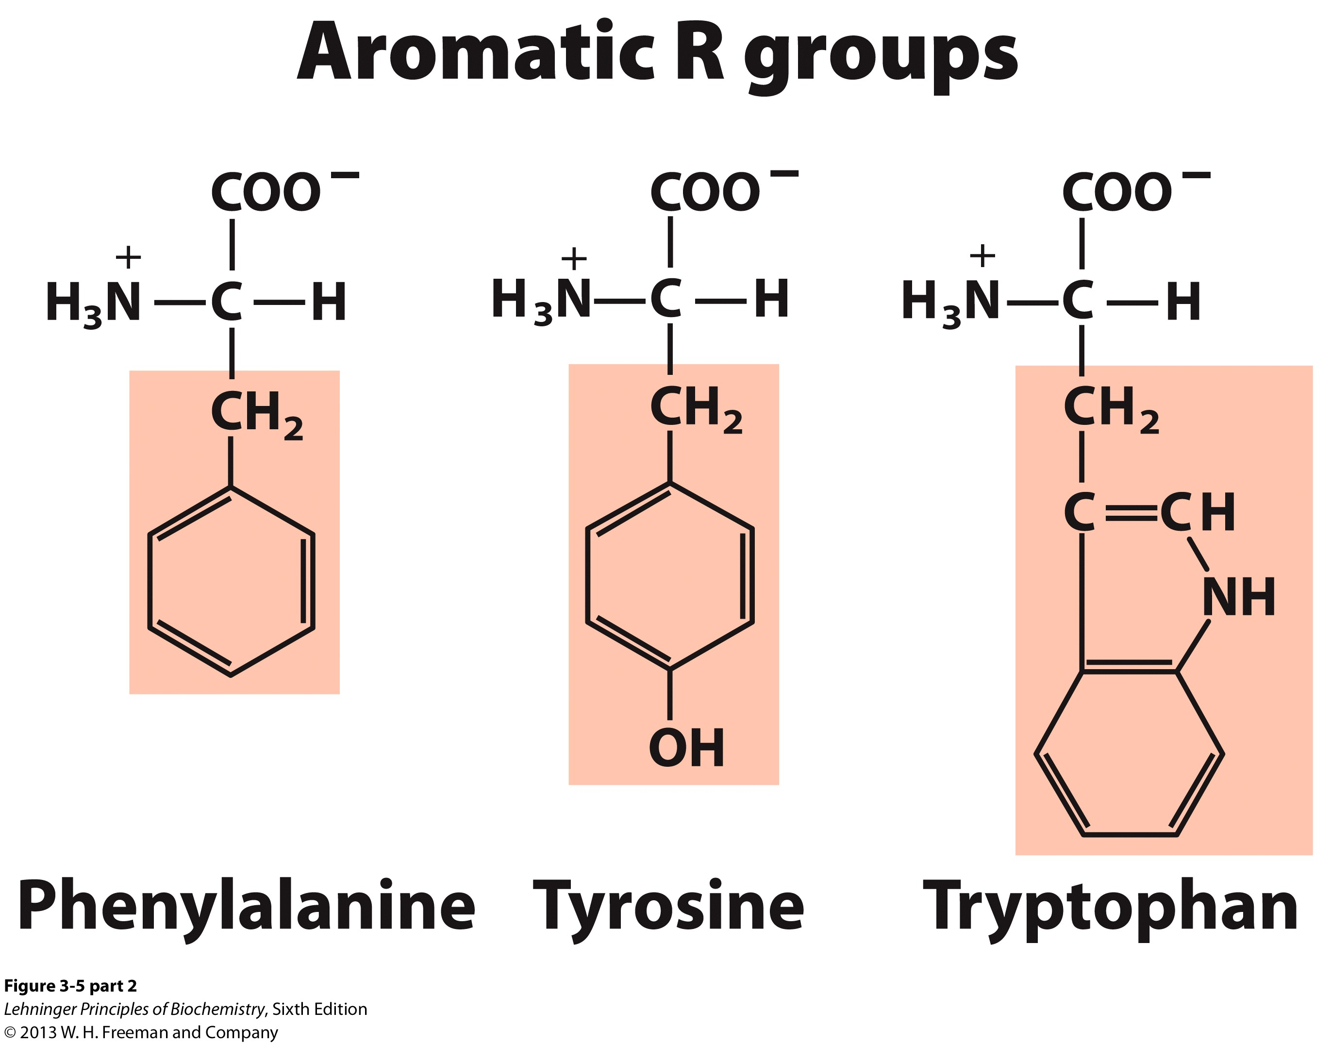
Aromatic side chains

Slide 27
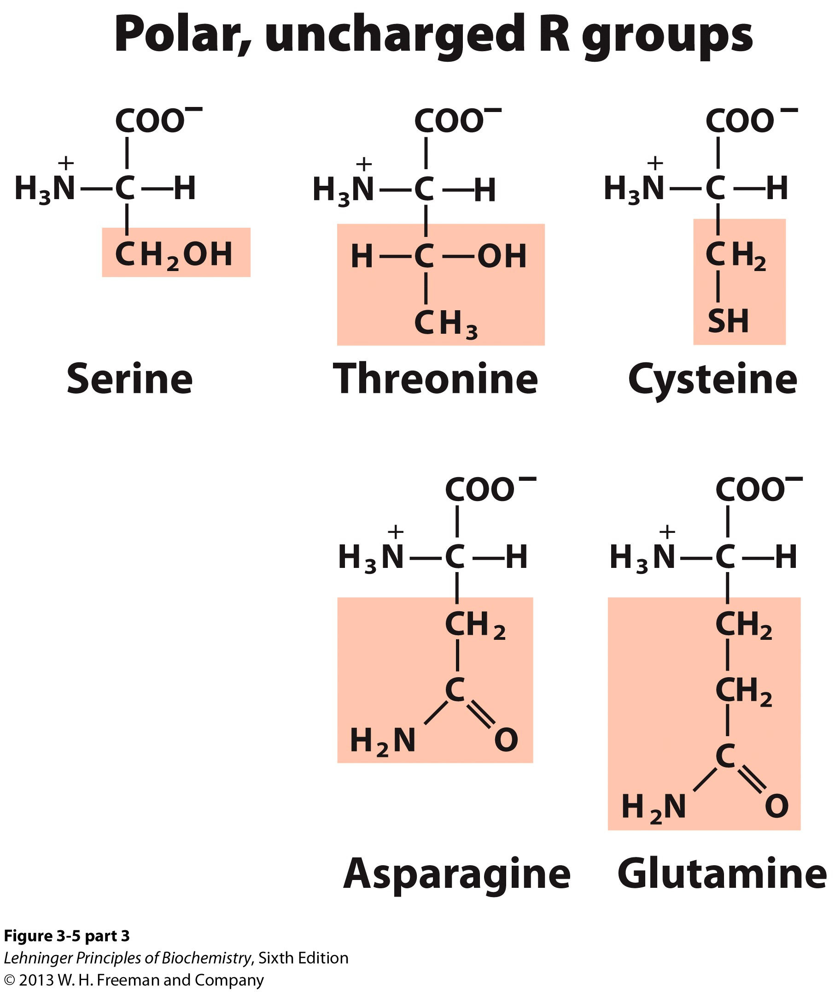
These amino acids side chains can form hydrogen bonds.

Slide 28
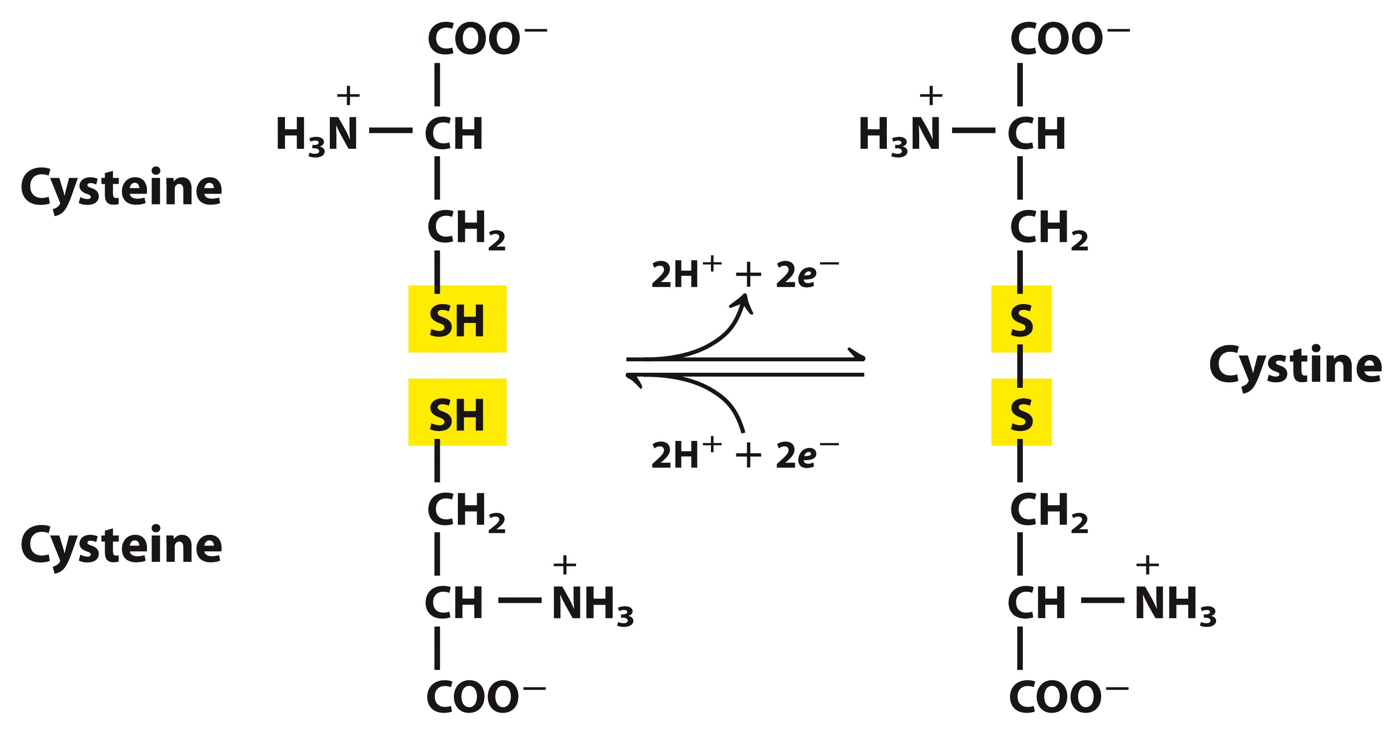
Two cysteines can be covalently linked by a disulfide bond

Slide 29
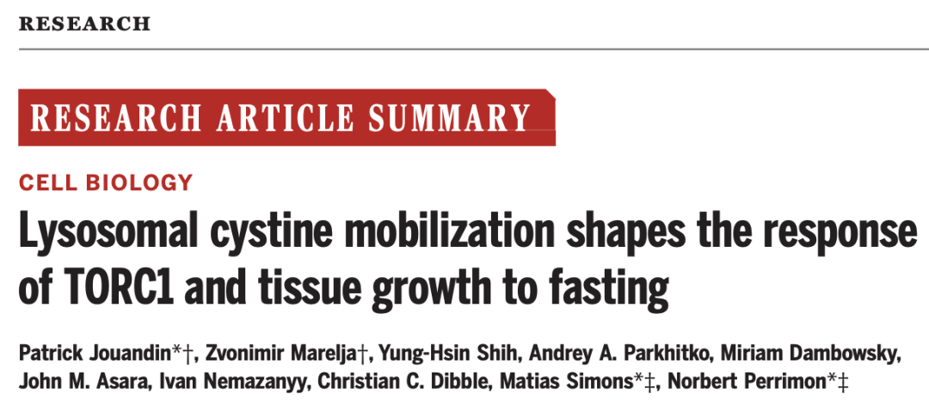
Science, 2022.02.18

Slide 30
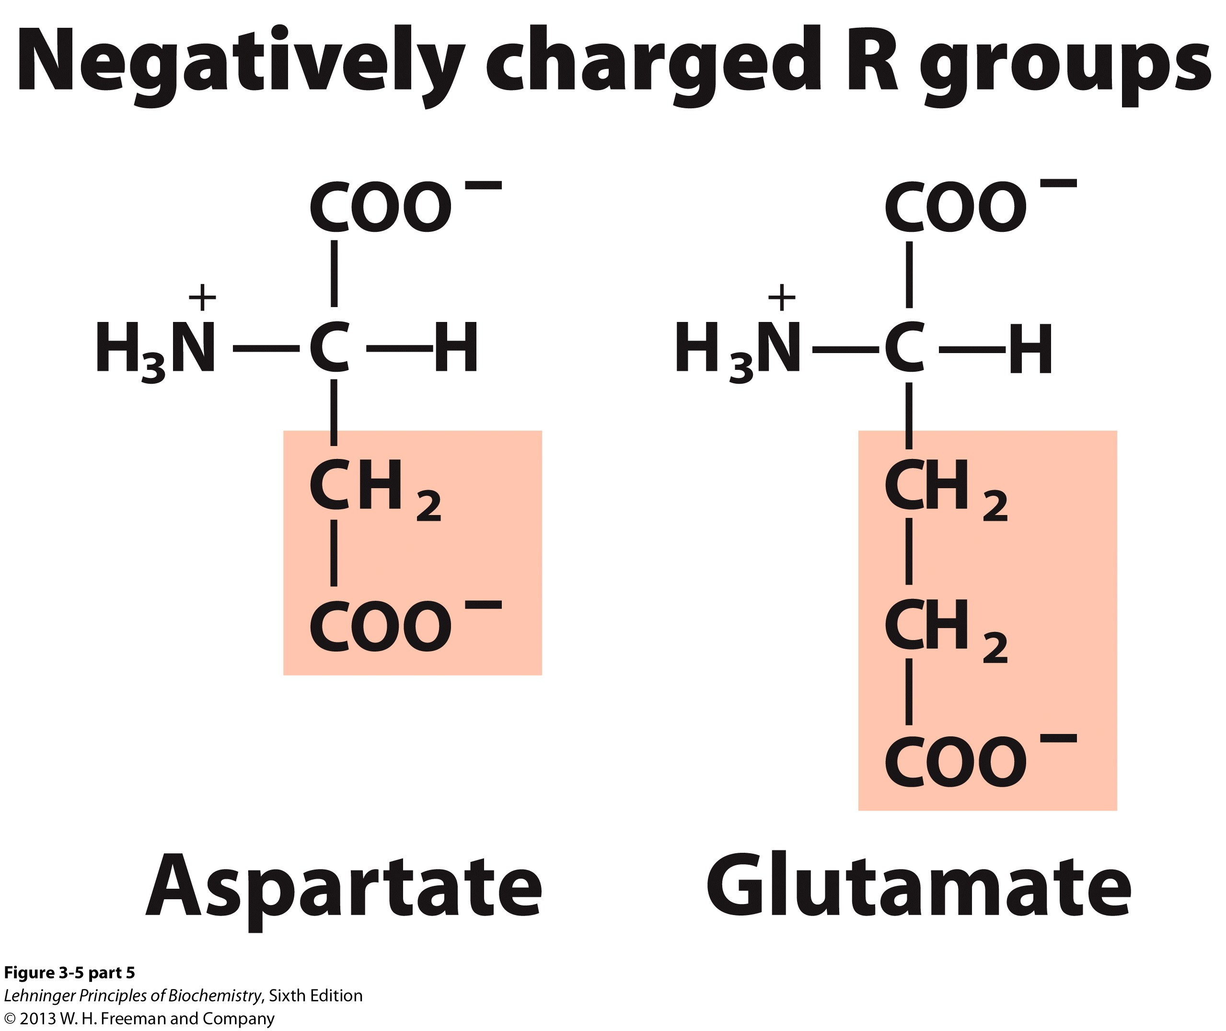

Slide 31
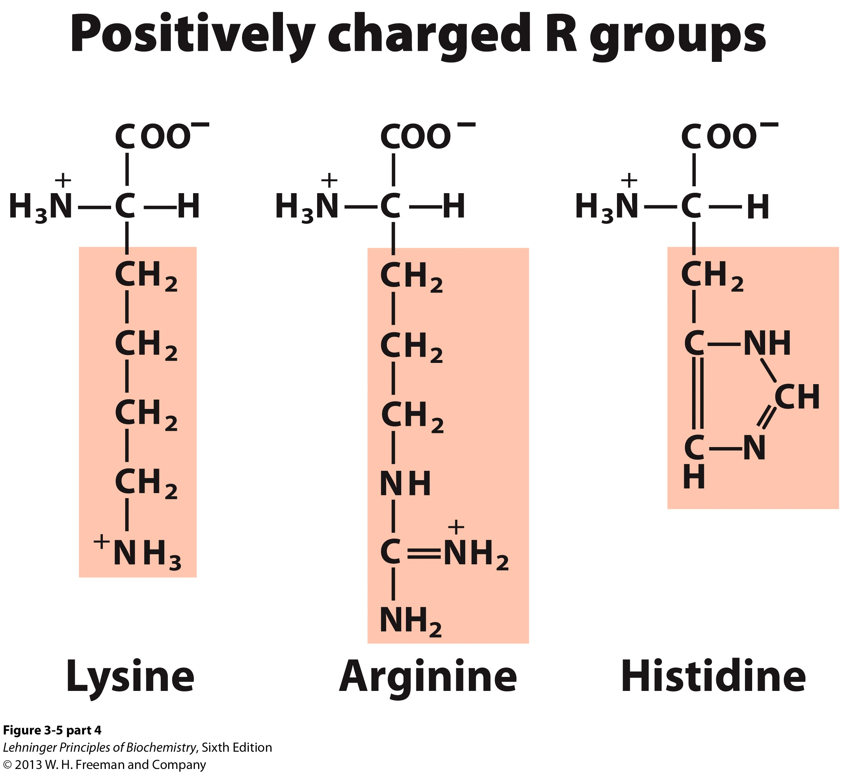

Slide 32
pKa = 6.0
How much histidine is positively charged at pH 7?

Slide 33
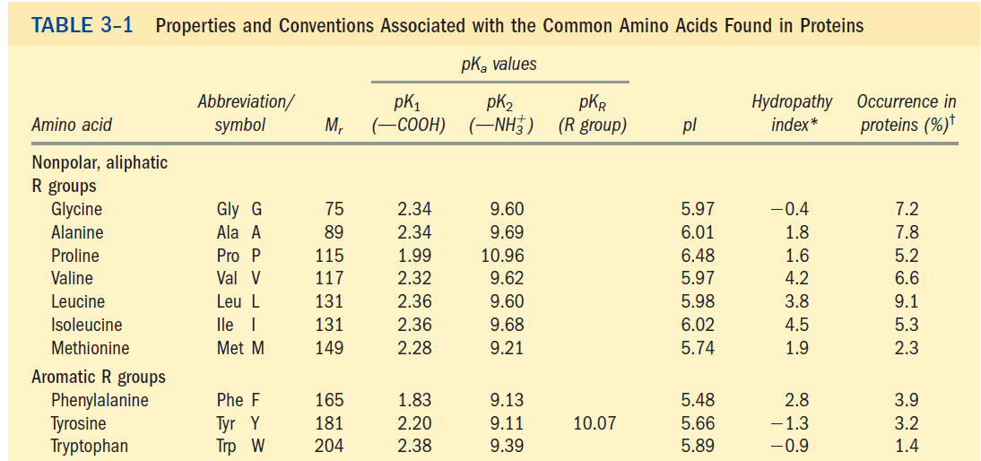
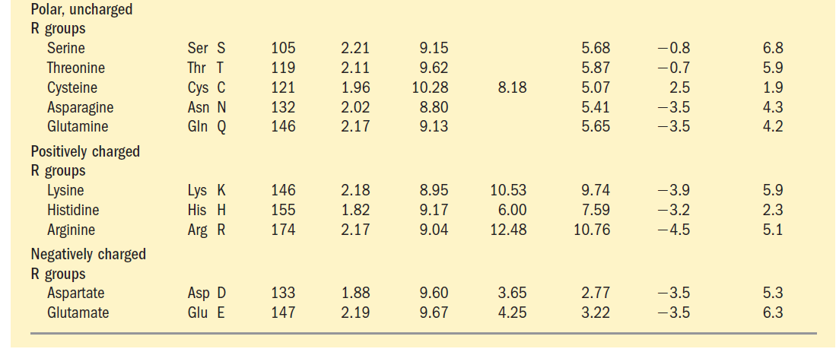

丝氨酸
苏氨酸
半胱氨酸
天冬酰胺
谷氨酰胺
赖氨酸
组氨酸
精氨酸
天冬氨酸
谷氨酸
甘氨酸
丙氨酸
脯氨酸
缬氨酸
亮氨酸
异亮氨酸
甲硫氨酸
苯丙氨酸
酪氨酸
色氨酸

Slide 34
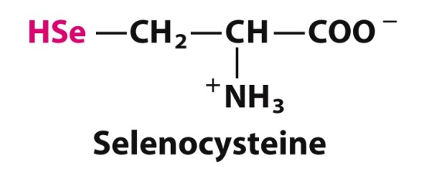
Selenocysteine (Sec, U, Se-Cys): the 21st amino acid

Slide 35
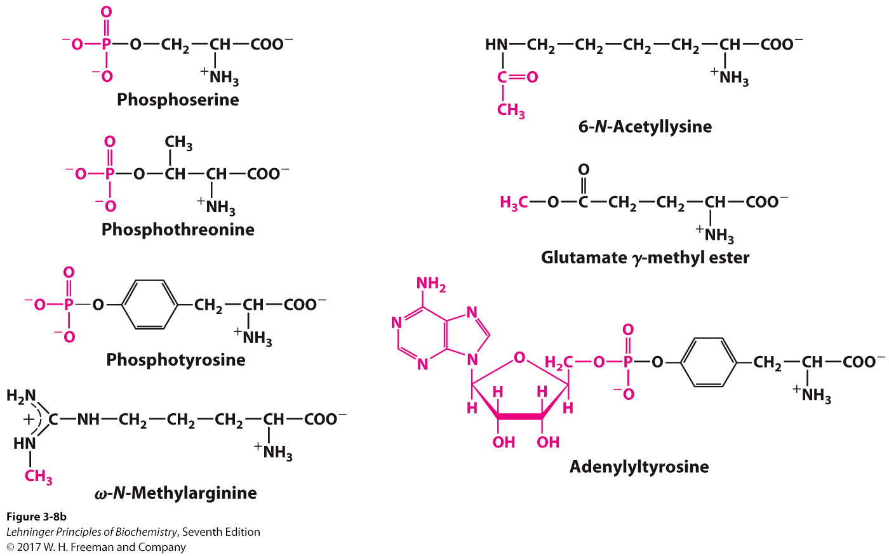
Post-translational modifications are common and important

Slide 36
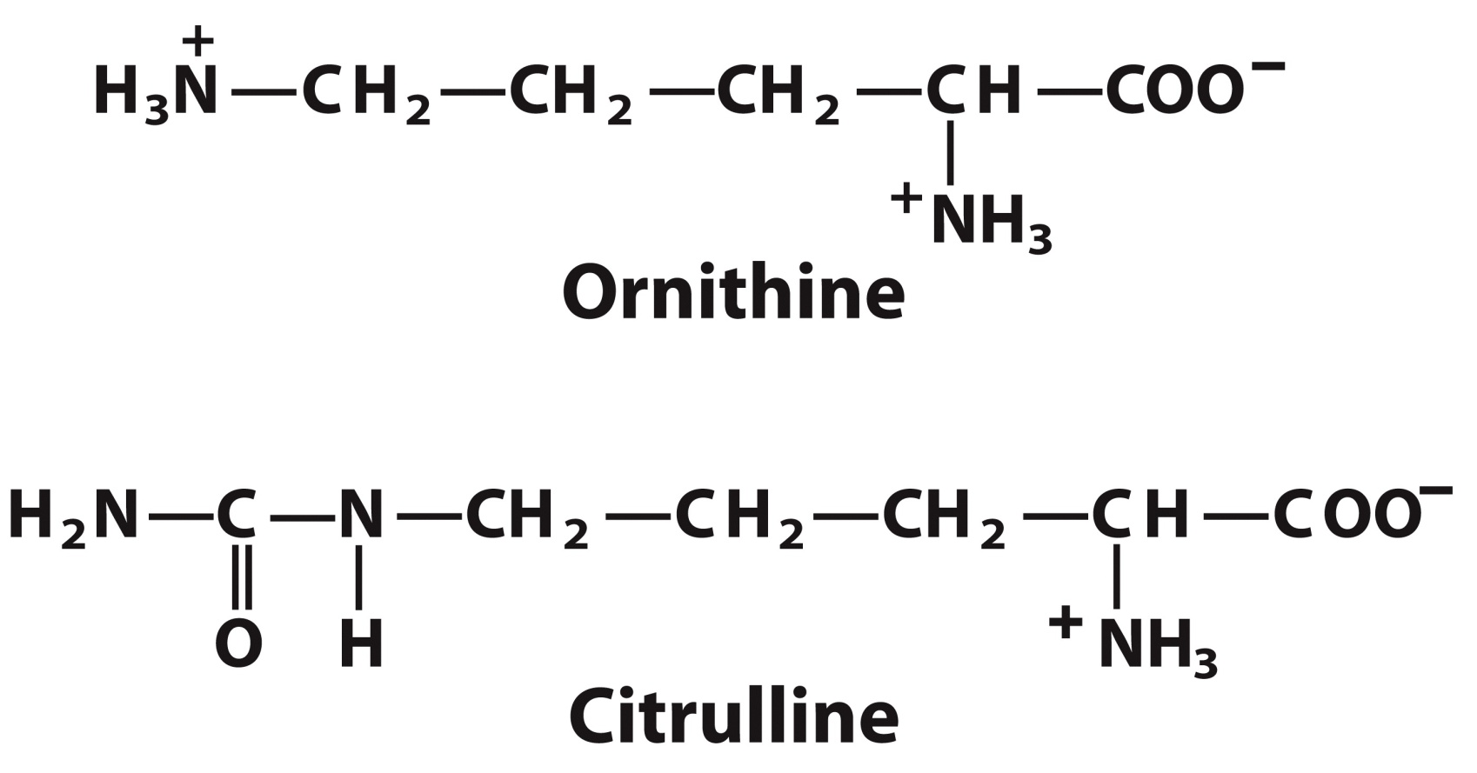
Many other amino acids are not constituents of proteins but intermediates in metabolic pathways

Slide 37
Ionization of Amino Acids
Amino acids contain at least two ionizable protons, each with its own pK_{a}.
The carboxylic acid has an acidic pK_{a} and will be protonated at an acidic (low) pH:
−COOH ↔ COO⁻ + H⁺
The amino group has a basic pK_{a} and will be protonated until basic pH (high) is achieved:
−NH₃⁺ ↔ NH₂ + H⁺

Slide 38
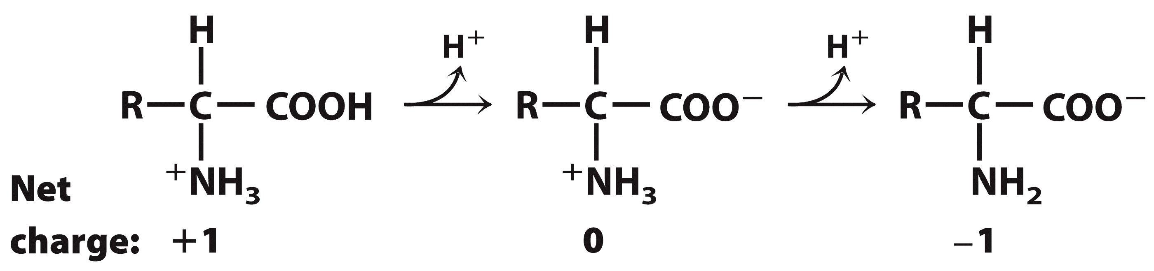
Ionization of Amino Acids
At low pH, the amino acid exists in a positively charged form (cation).
At high pH, the amion acid exists in a negatively charged form (anion).
Between the pK_{a} for each group, the amino acid exists in a zwitterion form, in which a single molecule has both a positive and negative charge.

Slide 39
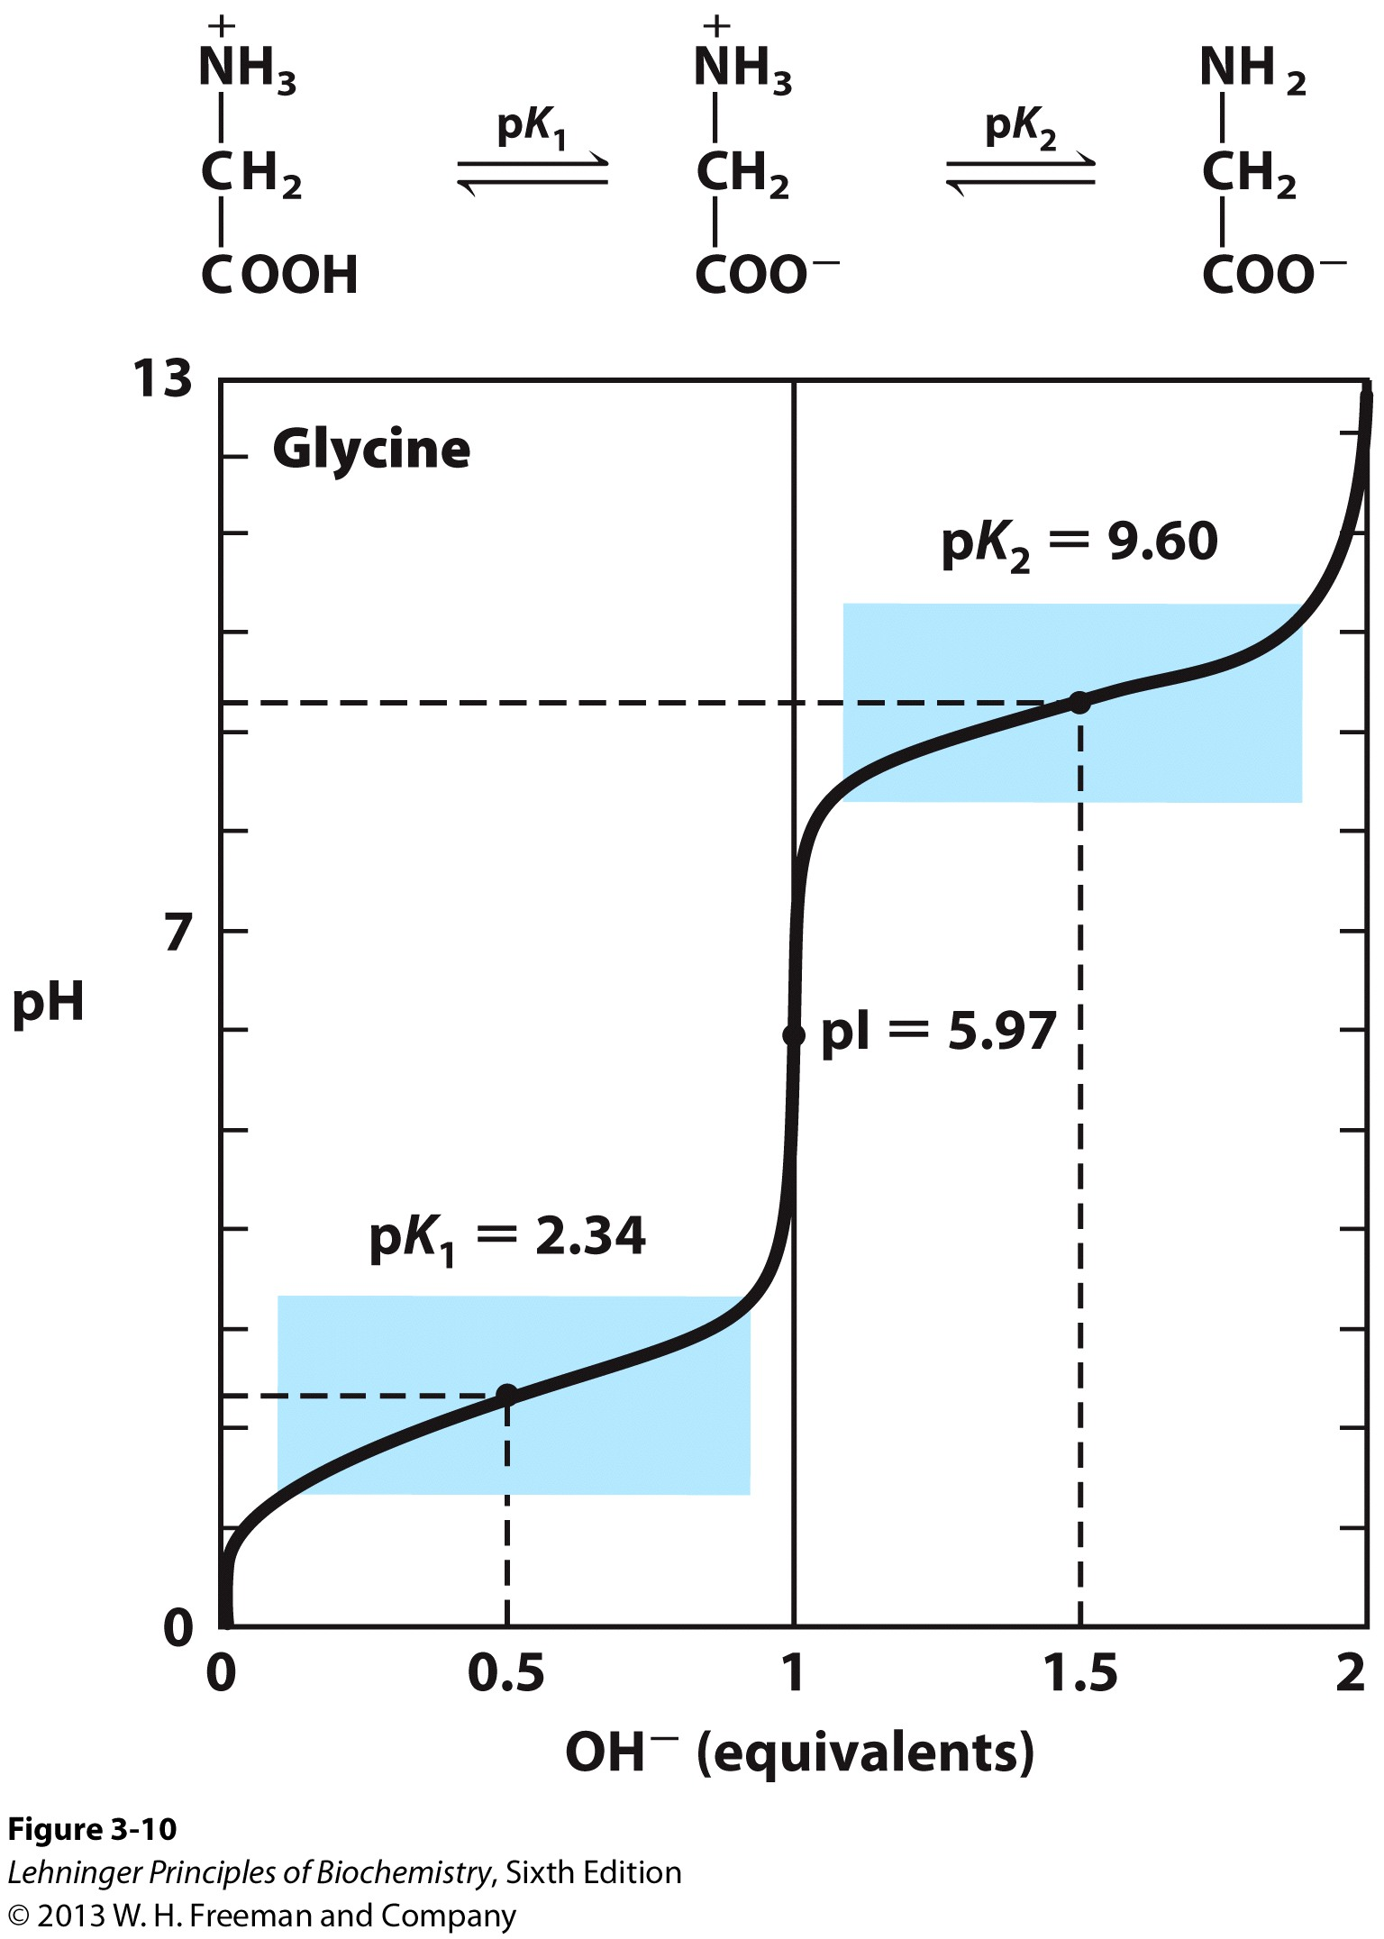
Amino Acids can act as buffers
Cation → Zwitterion → Anion
Amino acids with uncharged side chains, such as glycine, have two pK_{a} values:
The pK_{a} of the α-carboxyl group is 2.34.
The pK_{a} of the α-amino group is 9.6.
As buffers prevent change in pH close to the pK_{a}, glycine can act as a buffer in two pH ranges.

Slide 40
Each amino acid has a characteristic isoelectric point (pI) value
Net charge: +1 0 -1
pI (isoelectric pH, 等电点): the pH at which a molecule carries no net electric charge (thus would not migrate in an electric field).
For non-charged amino acids: pI = ½ (pK₁ + pK₂)
At pH > pI, an amino acid has net negative charge, and will move toward the positive electrode (anode); at pH < pI, an amino acid has net positive charge, and will thus will move toward the negative electrode (cathode);

Slide 41
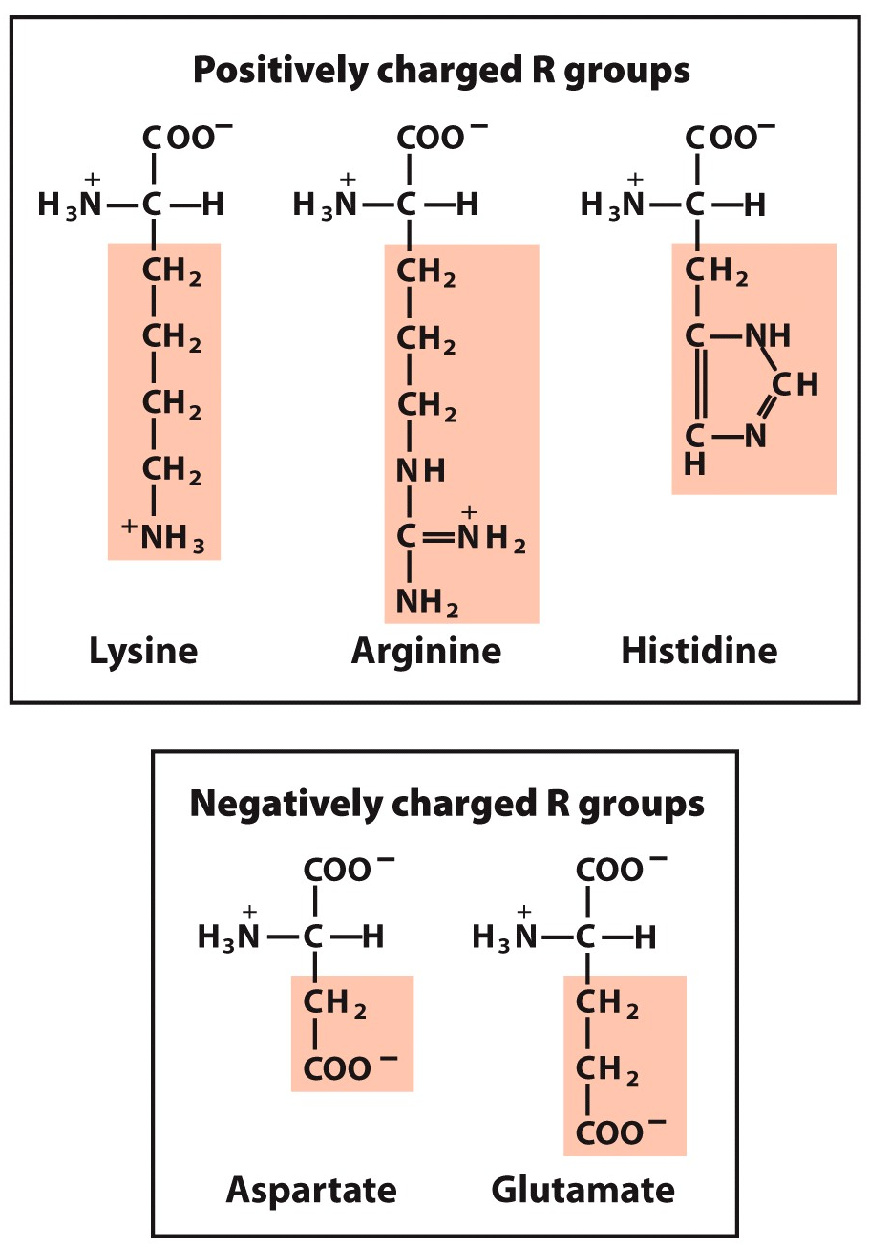
Ionizable side chains influence the pI of the amino acid

Slide 42
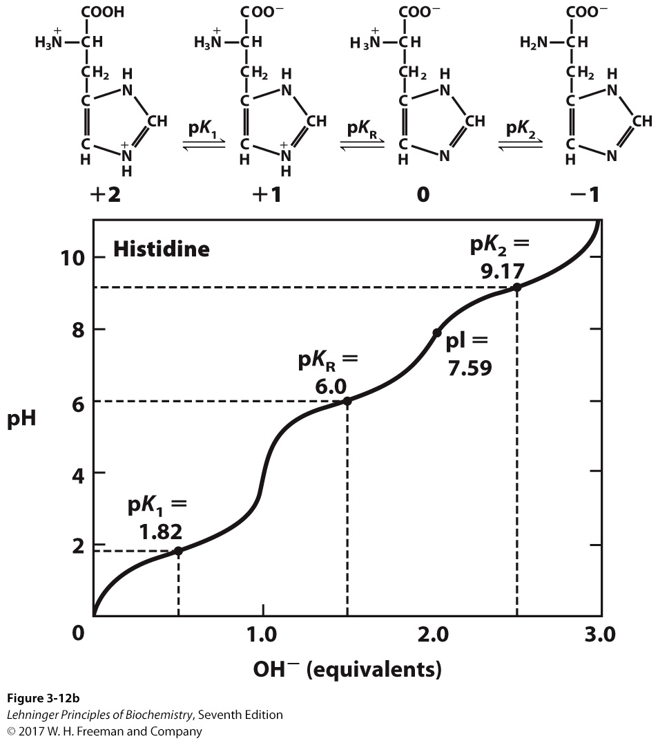
Notes:
FIGURE 3-12b Titration curves for (a) glutamate and (b) histidine. The pK_{a} of the R group is designated here as pK_{R}.

Slide 43
How to Calculate the pI of charged amino acids
Identify species that carries a net zero charge.
Identify the pK_{a} value that defines the acid strength of this zwitterion: (pK_{R}).
Identify the pK_{a} value that defines the base strength of this zwitterion: (pK₂).
Take the average of these two pK_{a} values.

Slide 44
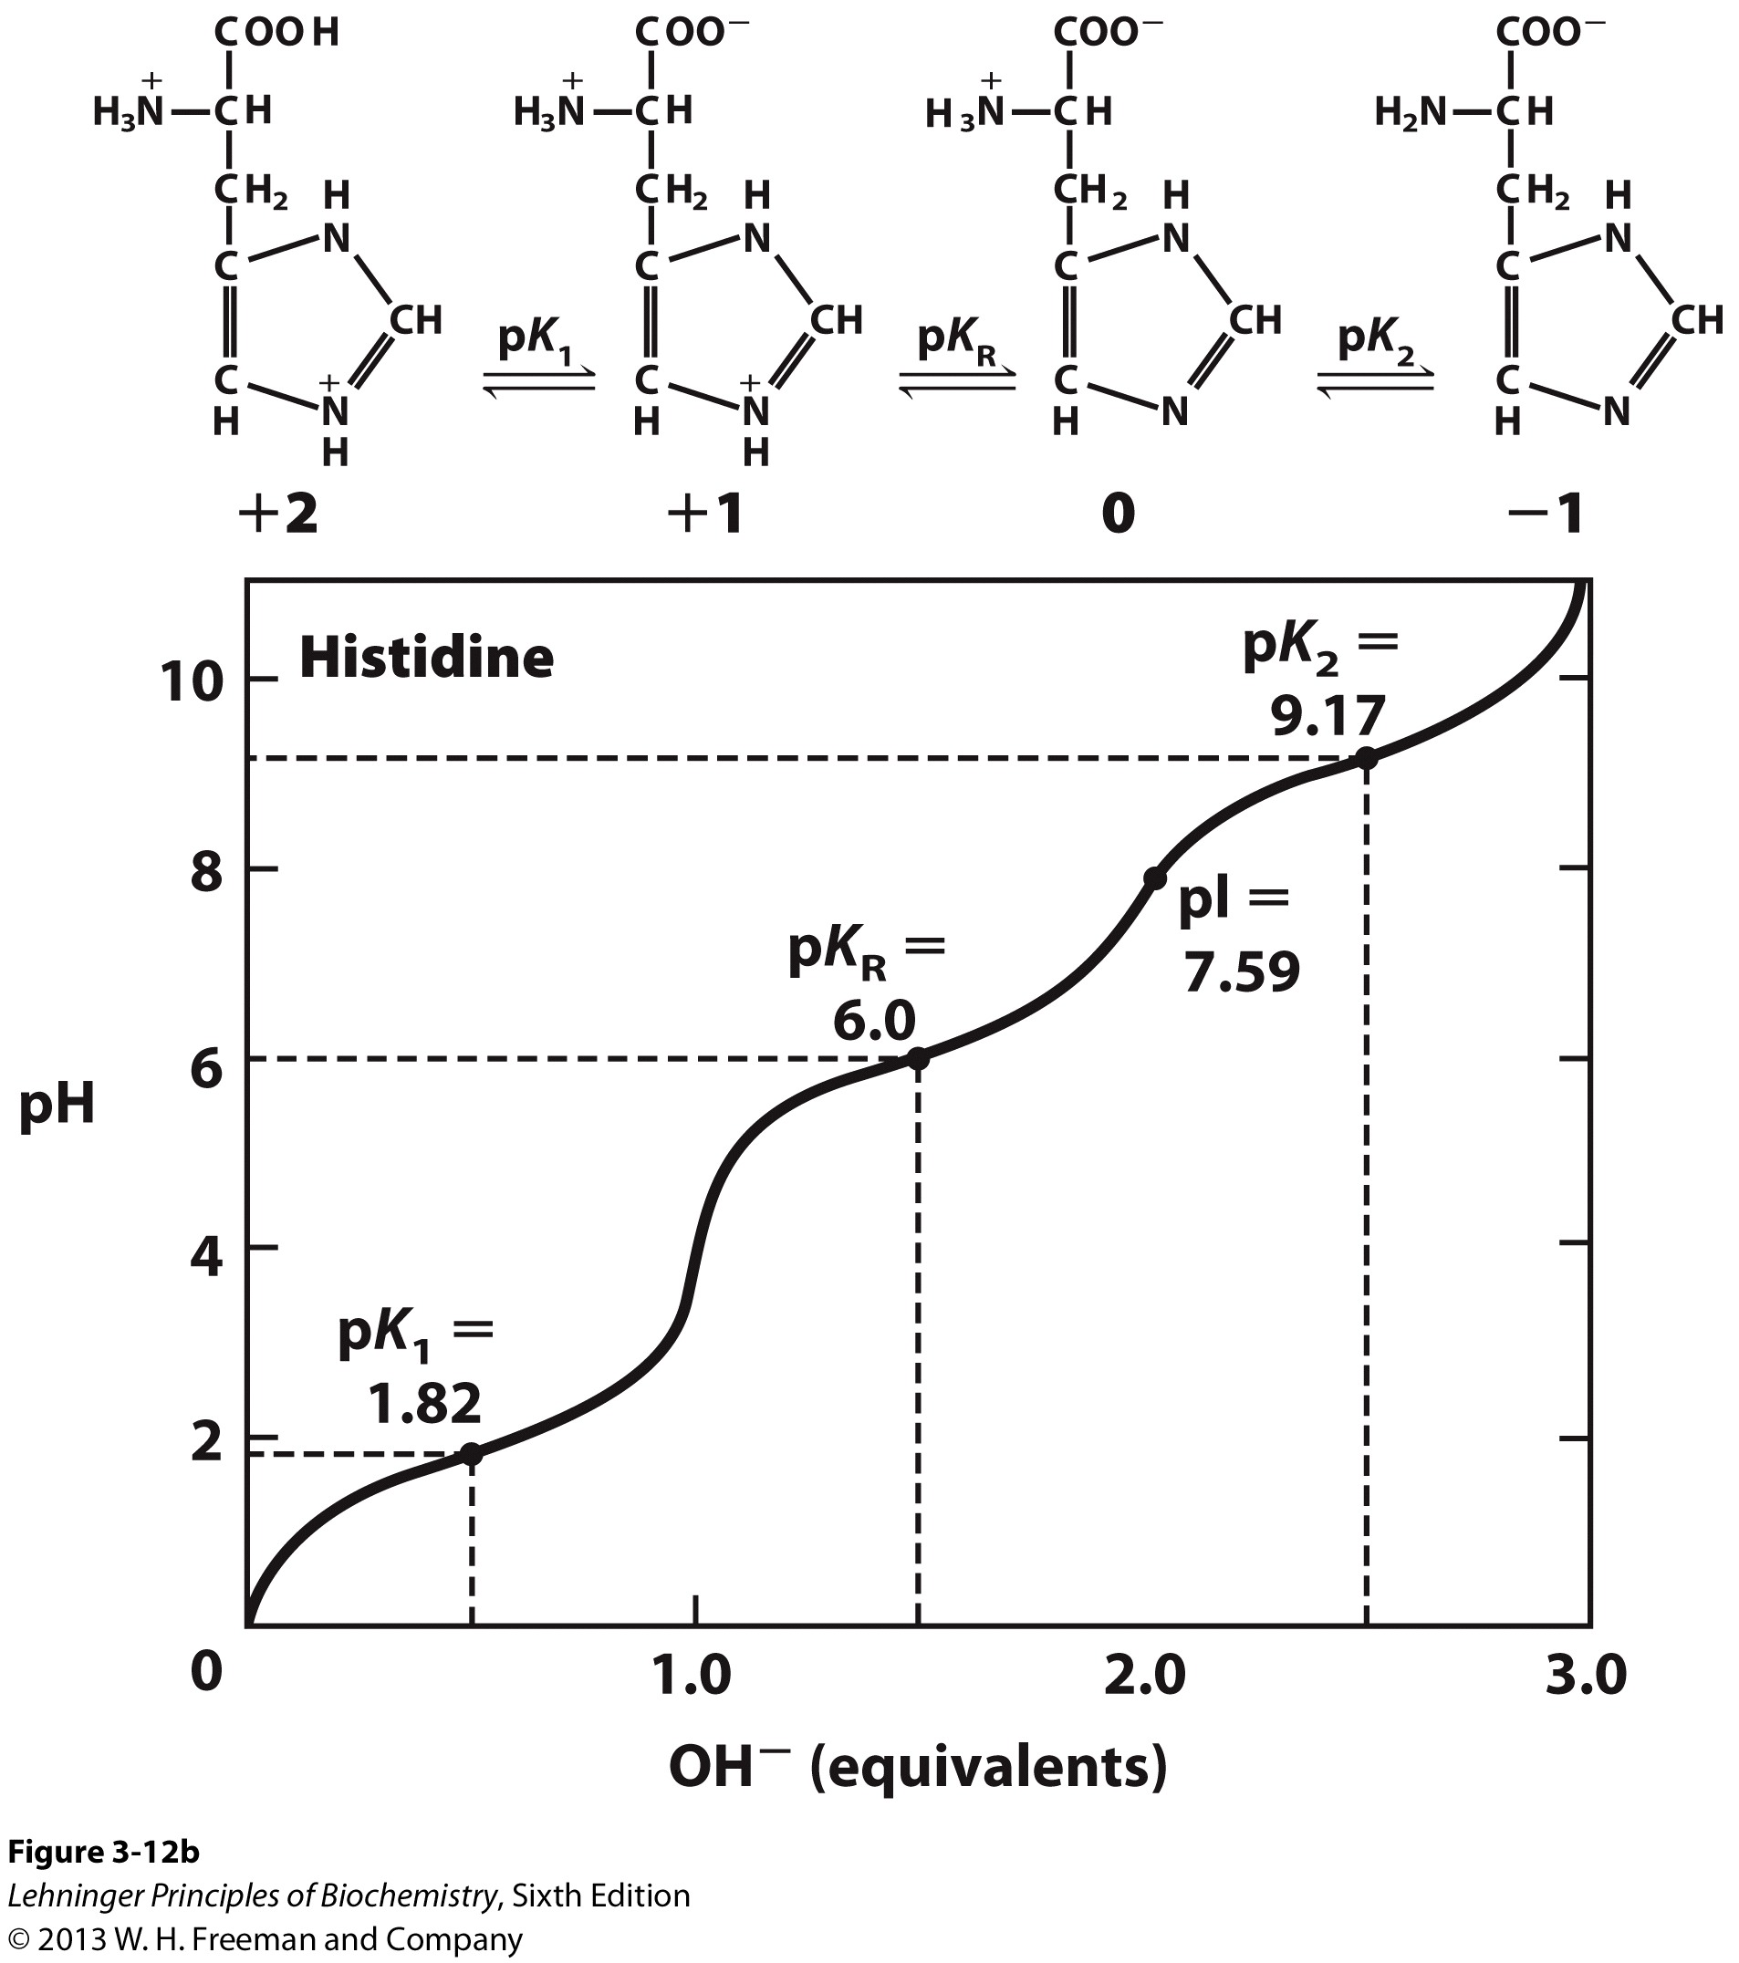
For basic amino acids, pI = ½(pK_{R} + pK₂)

Slide 45
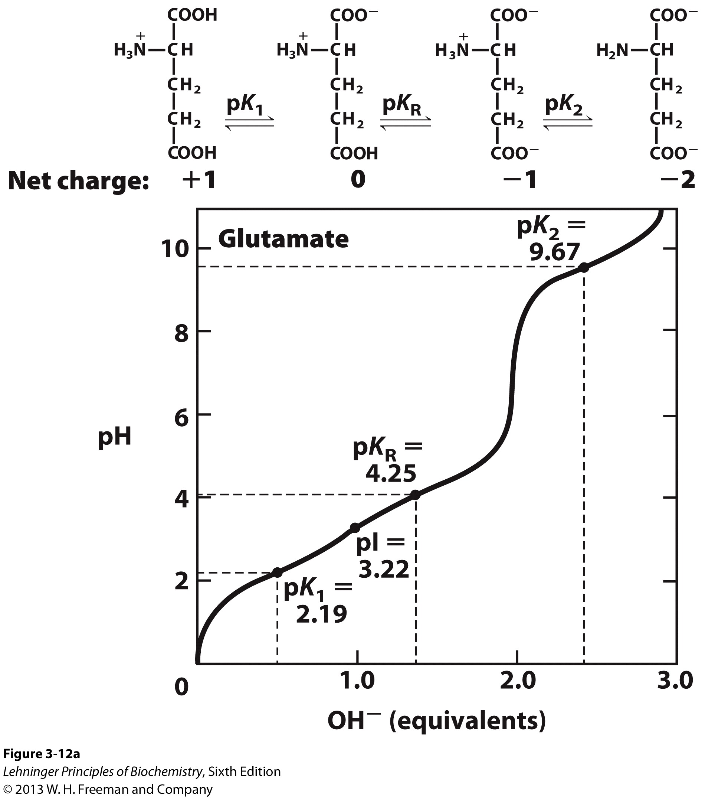
For acidic amino acids, pI = ½(pK₁ + pK_{R})

